Slide 1


ISSUE 1:
THE MIGRATION OF THE SCOTS

Slide 2

Examples Of How This Will Be Assessed:
10. Evaluate the usefulness of Source A as evidence of the reasons . for Scottish migration & emigration.

Slide 3
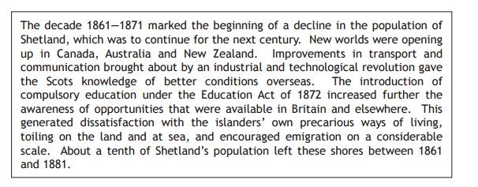
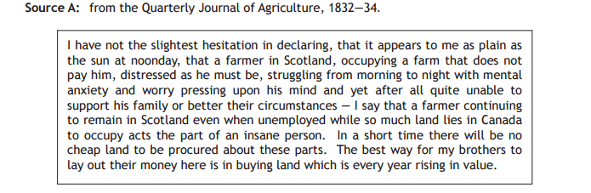
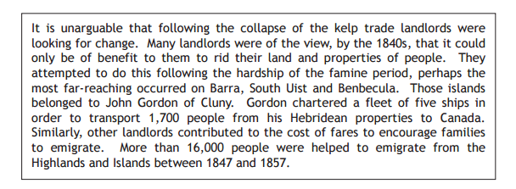
Read Through These Sources & See How Many Reason You Can Come Up With
4
..That Explain Why The Scots Emigrated
5-6
5

Slide 4
Read Through These Sources & See How Many Reason You Can Come Up With
..That Explain Why The Scots Emigrated

Slide 5

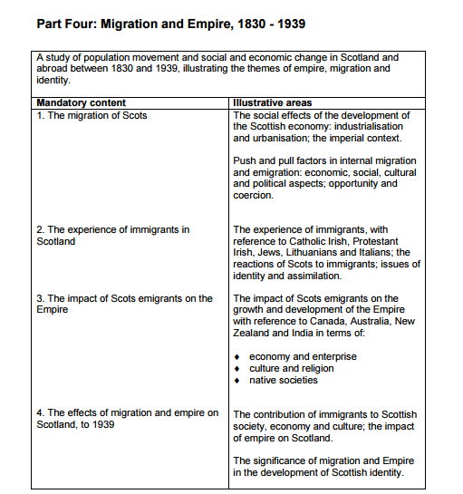
In this Issue we will look at 2 areas:
1. What PUSHED the Scots out AND around Scotland
AND
2. What PULLED the Scots to new AND countries
The Reasons For Internal Migration & Emigration Are VERY Similar/The Same
What PUSHED the Scots from their homes? (Internally or Overseas)
(12 Facts – you will learn 7-8)

Slide 6
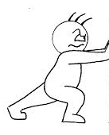
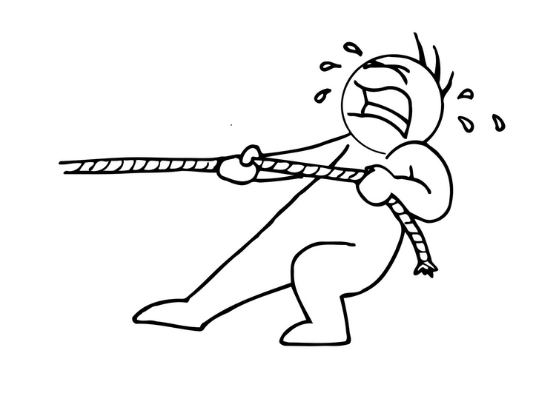
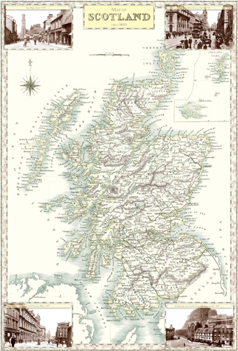
Highlanders Background
What were the reasons for Internal Migration?
Many moved from the countryside to the towns in search of work as well as social opportunities
It is important to realise there are many reasons for internal migration
The arrival of railways made it easier to move around
Movement was not always a choice – we will start by looking at the Highland Clearances (followed by the Lowlands)
Rural living conditions were poor & a potato blight led to famine

Slide 7
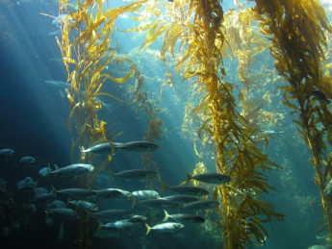
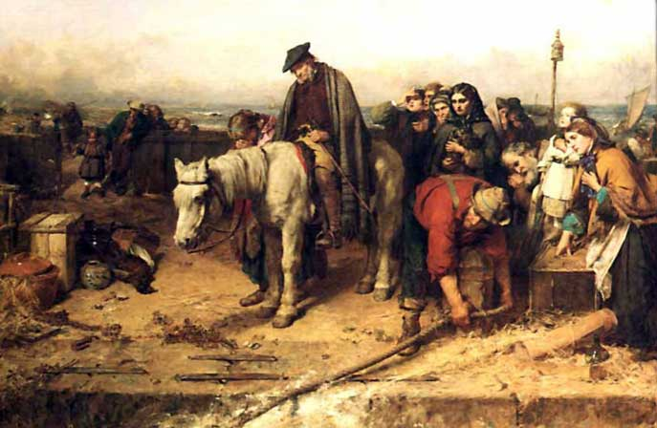
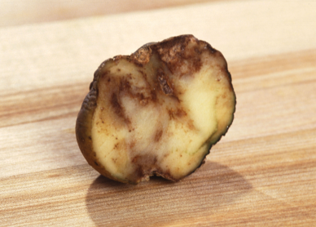
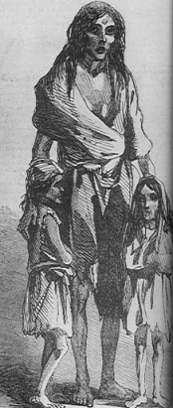
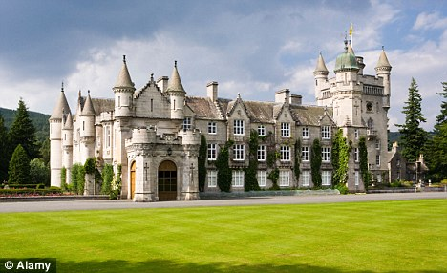

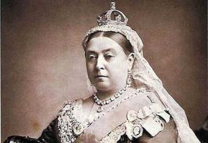


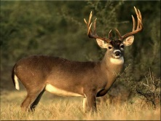
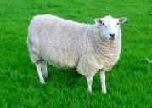

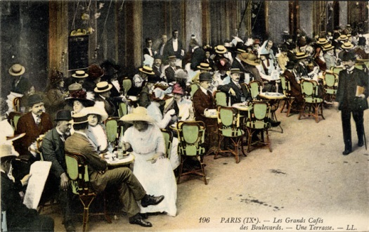
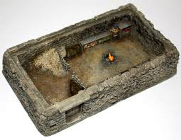

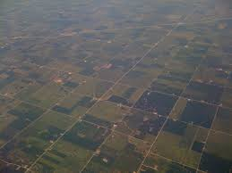
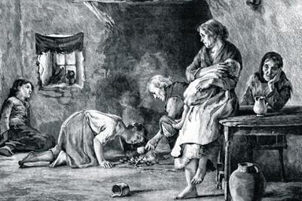
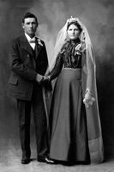
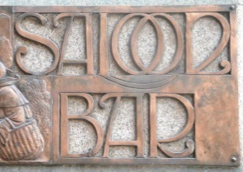


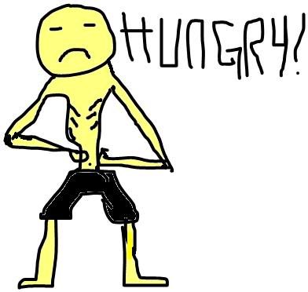
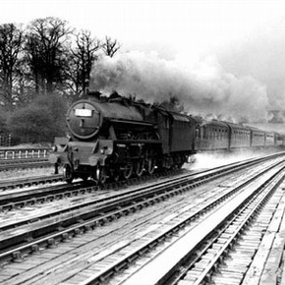
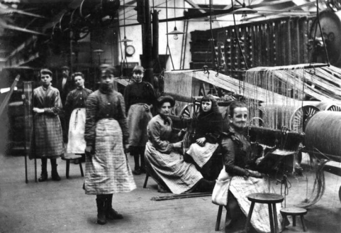
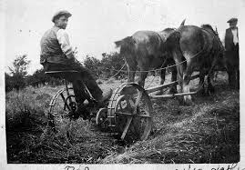
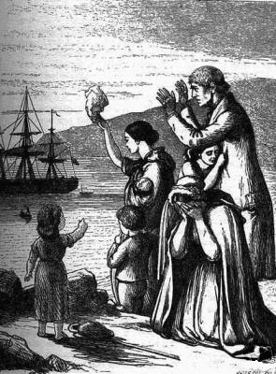
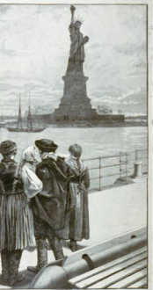
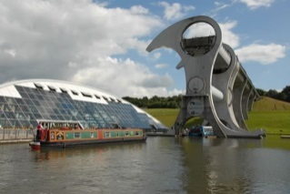
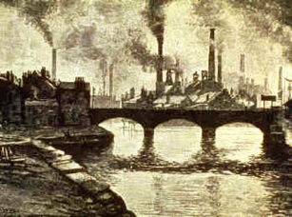
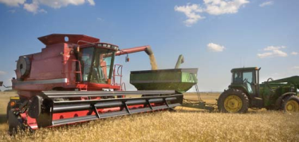

Lets See What You Know Already…
Failure of the kelp & industry & Herring | Highland Clearances – thrown off land to make way for sheep | Potato famine – leading to malnutrition & starvation | Balmoralism – tourism to the Highlands. Types of jobs required changed
Social life & higher wages offered in towns/cities | Living in bothy/black house – poor living conditions | England offered higher wages & better opportunities in trades & professions | Over population of the Highlands – land too small to make a living. Dowry
Railways and cannel made moving much easier for people & goods | Industrialisation meant the towns/cities offered jobs in factories | Invention of new farming machinery = less jobs on farms | Could not afford to go to USA or were too scared
Notes:
Fishing/kelping, Highland Clearances, potato famine, ‘Balmoralism’, attraction of the big city, poor housing, job opportunities down South, more marriages mean more dowries (which were often given in land rather than money) and so the land is divided up amongst more people leading to poverty, better transport – people could move easier, jobs in factories, mechanisation pushing people off the land, the appeal of America – greater political rights/’land of opportunity.’

Slide 8
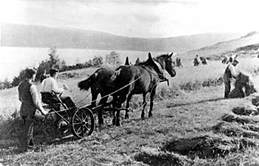
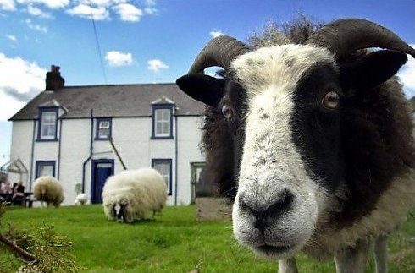
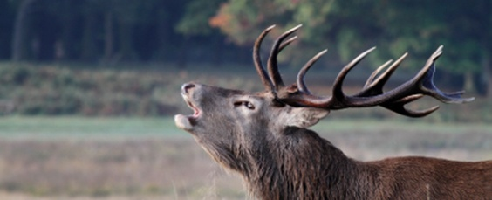
1. The Highlands of Scotland
Carousel Task
There are many reasons for internal migration in the Highlands. We are going to look at the 7 key problems which help explain the movement of people:
Problem 1 – Over populated Highland Region
Problem 2 – Highland Clearances
Problem 3 – Poor Living Conditions
Problem 4 – Failure of the Kelp Industry
Problem 5 – Balmoralism
Problem 6 – Poor Harvests/Potato Famine
Problem 7 – Fishing Industry
As you will see the economy of the Highlands saw great changes from the 18th century onwards.
This helps explain reasons for internal migration as the jobs available changed:
Crofting Families
Sheep
Deer/Grouse
Notes:
Pupils get into 7 groups, number each 1-7 then all 1’s go to Reason1; All 2’s go to Reason 2 – tell them to read through the information in their new groups so they can feedback to their original group. Have a class discussion of what they found then go over the slides. Get pupils to create a poster of the 7 problems facing the Highlanders

Slide 9
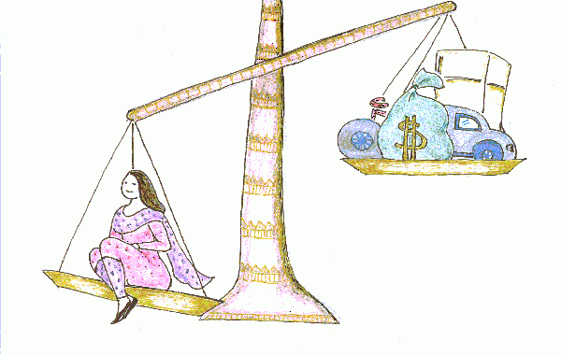
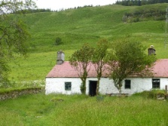
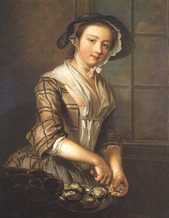
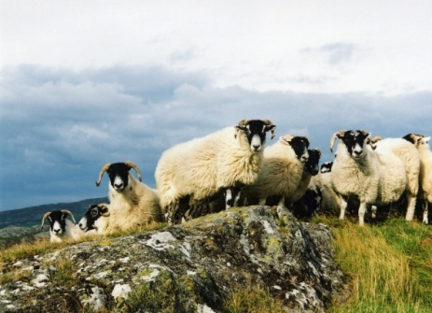
Reasons for Migration – The Highlands of Scotland
Reason 1 – Over populated Highland Region
The Highland population continued to grow leading to a lack of resources
Remember at this time a ‘dowry’ was customary - which meant croft land was continually divided & subdivided as women got married
The result of the smaller areas was that each generation families received less & less land to survive on.
Poverty hit & no longer could rents be paid – landowners were not happy…
The landlord saw sheep as a more profitable alternative – however the introduction of sheep meant the removal of people
It is true that the Highlanders suffered over population, resulting lack of land to grow food & pay rents - this was reason why some highlands choose to leave rather than being pushed as hunger was common

Slide 10
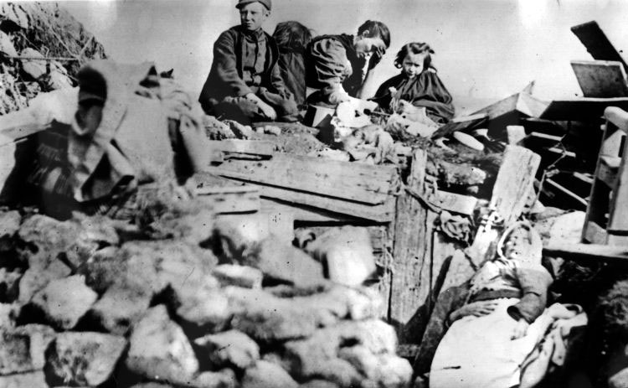
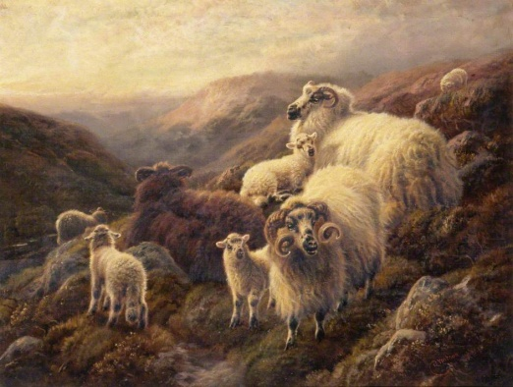
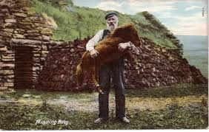
Reasons for Migration – The Highlands of Scotland
Reason 2 – Highland Clearances:
In brief the Highland Clearances meant the eviction of Highland crofters from their homes & small farms by force.
Landlords, did not feel responsibility for the Highlanders fate and organised evictions in order to create still more sheep farms.
Public opinion at the time sympathised with those being evicted & betrayed by the landowners- even raising money/aid in the major cities.
Landlord even went as far as to say they were helping the Highlanders by evicting them due to the poor quality of housing – ‘Blackhouses’ where animals shared the home with humans to keep warm – not as nice as it sounds!
It is true that the Highlanders were thrown from their land - this was a reason why some highlander migrated

Slide 11
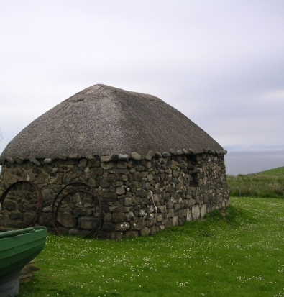
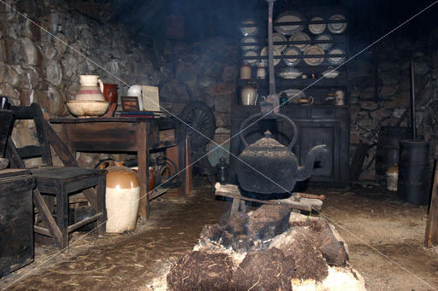

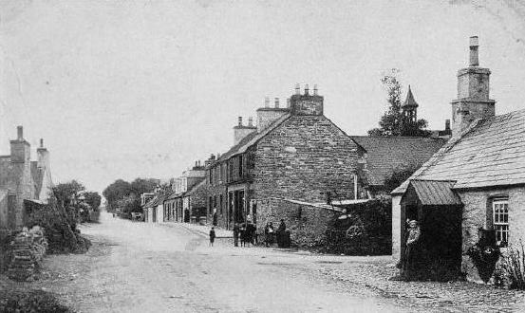
Reasons for Internal Migration – The Highlands of Scotland
Reason 3 – Poor Living Conditions:
Although this should not have been used as an excuse to evict the Highlanders, poor living conditions were a major problem & a reason why some Highlanders left through choice.
‘Blackhouses’ were dark, colds & damp.
They were also smoky due to there being no chimney or windows!
They also did not have flushing toilets or a piped water supply – no sanitation
These features led to the outbreak of disease like TB, cholera & typhoid
Many left their homes in the Highlands in search for better living conditions

Slide 12
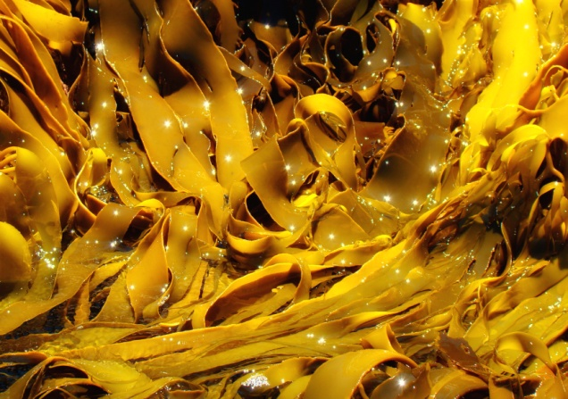
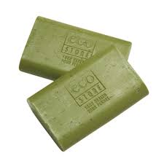


Reasons for Internal Migration – The Highlands of Scotland
Reason 4 – Failure of the Kelp Industry:
The Highland economy had collapsed not simply because of the lack of rents but also as a result of the reduced income from several industries – including kelp production
Kelp was used to make soap & glass.
It was very labour intensive so soaked by much of excess labourers.
However the use of chemicals to make soap & cheaper products imported meant the kelp industry died out.
Therefore some highlanders were forced to move due to lack of income

Slide 13
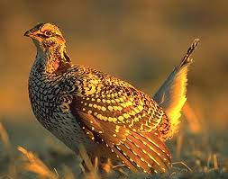
Reasons for Internal Migration – The Highlands of Scotland
Reason 5 – Balmoralism:
Queen Victoria’s regular visits to Balmoral Castle made it ‘cool’ for rich aristocrats to come to the highlands to holiday.
Landlords soon realised that the land could be used in a more cost efficient way; rich people wanted to mirror the lifestyle of the Royal Family - a term known as ‘Balmoralism’ – and so they made the land available for ‘hunting holidays’.
They came for the shooting estates (deer & grouse) therefore that is what the landowners gave them.
This created new jobs to the area in tourism and can explain internal migration within Scotland

Slide 14
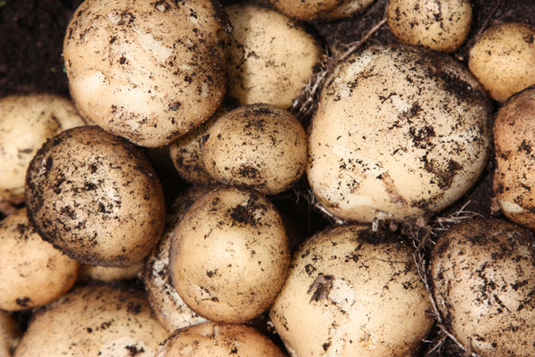

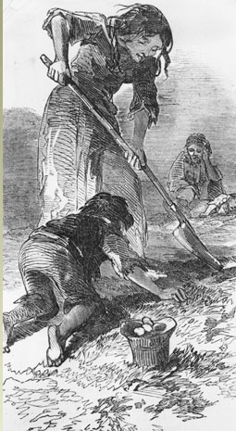
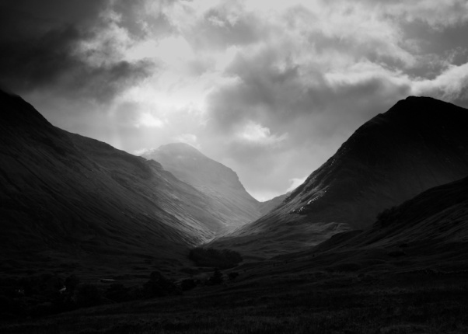
Reasons for Internal Migration – The Highlands of Scotland
Reason 6 – Poor Harvests/Potato Famine
The Highland & Islands depended greatly on the land, namely the potato, as a means of survival.
In 1846 a potato blight wiped out the potato crop on the west coast of Scotland.
This lasted longer than the Irish potato famine!
Farmers also experienced pressures due to poor quality soil and harsh weather conditions.
Incessant rain had made it impossible for the population of the west coast to harvest the peat on which they depended for domestic fuel.

Slide 15
Reasons for Internal Migration – The Highlands of Scotland
Reason 7 – Fishing Industry:
  In the 1870s, the herring industry drew in migrants with as many as 5000 men and women arriving in the fishing ports of Caithness and Aberdeenshire during the catching season – this is one explanation of internal migration
  However a more important reason for migration was due to the First World War. This period was problematic to this industry and an irreversible trend began... WHY?
  Fishing town lost around a quarter of their overall population due to conscription.
  Also, WWI saw the Scottish East coast ports taken over by the navy – and as a result fishing was almost complete stopped.
  Many boats that were previously used fishing were now being used by the navy for jobs like minesweeping.
  After the war many of boats needed repaired and the money on compensation given was not enough to improve the boats so fishermen went out of business.
  The Russian Revolution saw an end to the massive export trade in herring to eastern Europe - the men who worked on trawlers lost the jobs. This was devastating.
  The Fishing industry helps explain internal migration for both push & pull reasons.

Slide 16

Thomas Faed -
The Last of the Clan
What were the Highland Clearances?
Notes:
Show video & discuss painting http://www.educationscotland.gov.uk/video/n/video_tcm4567279.asp?strReferringChannel=higherscottishhistory&strReferringPageID=tcm:4-570327-64

Slide 17
50:50
Welcome to
Who Wants to be a Millionaire
Migration & Empire Edition
15
£1 Million
14
£500,000
13
£250,000
12
£125,000
11
£64,000
10
£32,000
9
£16,000
8
£8,000
7
£4,000
6
£2,000
5
£1,000
4
£500
3
£300
2
£200
1
£100

Slide 18

15
£1 Million
14
£500,000
13
£250,000
12
£125,000
11
£64,000
10
£32,000
9
£16,000
8
£8,000
7
£4,000
6
£2,000
5
£1,000
4
£500
3
£300
2
£200
1
£100

Slide 19
15
£1 Million
14
£500,000
Q1. What is the name for a Highland farmer?
13
£250,000
12
£125,000
11
£64,000
10
£32,000
9
£16,000
8
£8,000
7
£4,000
6
£2,000
5
£1,000
4
£500
3
£300
2
£200
50:50
1
£100
A: Highland Farmers
B:Crofters
C: Teuchter
D: Bankers

Slide 20
15
£1 Million
14
£500,000
13
£250,000
12
£125,000
11
£64,000
10
£32,000
9
£16,000
8
£8,000
7
£4,000
6
£2,000
5
£1,000
4
£500
3
£300
2
£200
1
£100

Slide 21
15
£1 Million
14
£500,000
13
£250,000
12
£125,000
Q2. Why were sheep introduced into the Highlands?
11
£64,000
10
£32,000
9
£16,000
8
£8,000
7
£4,000
6
£2,000
5
£1,000
4
£500
3
£300
2
£200
50:50
1
£100
A: As the crofters refused to pay rent
B: Because tourists wanted them
C: the landlords didn’t like the crofters
D: As the landlords wanted to make lots of money

Slide 22
15
£1 Million
14
£500,000
13
£250,000
12
£125,000
11
£64,000
10
£32,000
9
£16,000
8
£8,000
7
£4,000
6
£2,000
5
£1,000
4
£500
3
£300
2
£200
1
£100

Slide 23
15
£1 Million
Q3. What was the land owners justification for evicting the highlanders?
14
£500,000
13
£250,000
12
£125,000
11
£64,000
10
£32,000
9
£16,000
8
£8,000
7
£4,000
6
£2,000
5
£1,000
4
£500
3
£300
2
£200
50:50
1
£100
A:They were living in too poor conditions
B: Sheep were needed
C: They were trouble
D: Tourists made more money

Slide 24
15
£1 Million
14
£500,000
13
£250,000
12
£125,000
11
£64,000
10
£32,000
9
£16,000
8
£8,000
7
£4,000
6
£2,000
5
£1,000
4
£500
3
£300
2
£200
1
£100

Slide 25
15
£1 Million
14
£500,000
13
£250,000
12
£125,000
Q4. Why did the term ‘dowry’ lead to reduced croft sizes?
11
£64,000
10
£32,000
9
£16,000
8
£8,000
7
£4,000
6
£2,000
5
£1,000
4
£500
3
£300
2
£200
50:50
1
£100
A: Families had to give land away to new husband
B: Families had to give land to new wife
C: Families hated each other would not live together
D: Land owners wanted to downsize their properties

Slide 26
15
£1 Million
14
£500,000
13
£250,000
12
£125,000
11
£64,000
10
£32,000
9
£16,000
8
£8,000
7
£4,000
6
£2,000
5
£1,000
4
£500
3
£300
2
£200
1
£100

Slide 27
15
£1 Million
Q5. What did land owners in the Highland's replace the small crofts with?
14
£500,000
13
£250,000
12
£125,000
11
£64,000
10
£32,000
9
£16,000
8
£8,000
7
£4,000
6
£2,000
5
£1,000
4
£500
3
£300
2
£200
50:50
1
£100
A: Cows
B: farmers
C: Sheep
D: Tourists

Slide 28
Congratulations!
Congratulations!
Congratulations!
You’ve Reached
the £1,000
Milestone!

Slide 29
15
£1 Million
14
£500,000
13
£250,000
12
£125,000
11
£64,000
10
£32,000
9
£16,000
8
£8,000
7
£4,000
6
£2,000
5
£1,000
4
£500
3
£300
2
£200
1
£100

Slide 30
15
£1 Million
14
£500,000
13
£250,000
12
£125,000
Q6. What was the name of the houses that crofters stayed in?
11
£64,000
10
£32,000
9
£16,000
8
£8,000
7
£4,000
6
£2,000
5
£1,000
4
£500
3
£300
2
£200
50:50
1
£100
A: White Houses
B: Black houses
C: Farms
D: Slums

Slide 31
15
£1 Million
14
£500,000
13
£250,000
12
£125,000
11
£64,000
10
£32,000
9
£16,000
8
£8,000
7
£4,000
6
£2,000
5
£1,000
4
£500
3
£300
2
£200
1
£100

Slide 32
15
£1 Million
14
£500,000
13
£250,000
Q7. What diseases broke out due to poor sanitation?
12
£125,000
11
£64,000
10
£32,000
9
£16,000
8
£8,000
7
£4,000
6
£2,000
5
£1,000
4
£500
3
£300
2
£200
50:50
1
£100
A: Verucas
B: Scottish Flu
C: Whooping cough
D: TB, cholera & typhoid

Slide 33
15
£1 Million
14
£500,000
13
£250,000
12
£125,000
11
£64,000
10
£32,000
9
£16,000
8
£8,000
7
£4,000
6
£2,000
5
£1,000
4
£500
3
£300
2
£200
1
£100

Slide 34
15
£1 Million
14
£500,000
13
£250,000
Q8.What is kelp?
12
£125,000
11
£64,000
10
£32,000
9
£16,000
8
£8,000
7
£4,000
6
£2,000
5
£1,000
4
£500
3
£300
2
£200
50:50
1
£100
A: Seaweed
B: disease
C: A type of cabbage
D: A fish

Slide 35
15
£1 Million
14
£500,000
13
£250,000
12
£125,000
11
£64,000
10
£32,000
9
£16,000
8
£8,000
7
£4,000
6
£2,000
5
£1,000
4
£500
3
£300
2
£200
1
£100

Slide 36
15
£1 Million
14
£500,000
13
£250,000
Q9. What is interesting about our potato famine?
12
£125,000
11
£64,000
10
£32,000
9
£16,000
8
£8,000
7
£4,000
6
£2,000
5
£1,000
4
£500
3
£300
2
£200
50:50
1
£100
A: Scots lost weight as couldn’t fry chips
B: It only lasted 3 weeks
C: Lasted longer than in Ireland
D: Never actually happened

Slide 37
15
£1 Million
14
£500,000
13
£250,000
12
£125,000
11
£64,000
10
£32,000
9
£16,000
8
£8,000
7
£4,000
6
£2,000
5
£1,000
4
£500
3
£300
2
£200
1
£100

Slide 38
15
£1 Million
14
£500,000
13
£250,000
12
£125,000
Q10. Why did WWI harm the fishing industry?
11
£64,000
10
£32,000
9
£16,000
8
£8,000
7
£4,000
6
£2,000
5
£1,000
4
£500
3
£300
2
£200
50:50
1
£100
A: Soldiers refused to eat fish
B: Everyone became vegetarian to save money
D: Men away fighting & ruined boats after the war
C: Kaiser Wilhelm ordered lots of fish

Slide 39
Congratulations!
Congratulations!
Congratulations!
You’ve Reached
the £32,000
Milestone!

Slide 40
15
£1 Million
14
£500,000
13
£250,000
12
£125,000
11
£64,000
10
£32,000
9
£16,000
8
£8,000
7
£4,000
6
£2,000
5
£1,000
4
£500
3
£300
2
£200
1
£100

Slide 41
15
£1 Million
14
£500,000
13
£250,000
12
£125,000
Q11. What was kelp used to make?
11
£64,000
10
£32,000
9
£16,000
8
£8,000
7
£4,000
6
£2,000
5
£1,000
4
£500
3
£300
2
£200
50:50
1
£100
A: Sheep food
B: Soap & glass
C: Dinner for Highlanders
D: Soles of shoes

Slide 42
15
£1 Million
14
£500,000
13
£250,000
12
£125,000
11
£64,000
10
£32,000
9
£16,000
8
£8,000
7
£4,000
6
£2,000
5
£1,000
4
£500
3
£300
2
£200
1
£100

Slide 43
15
£1 Million
14
£500,000
Q13. What are pull factors for migration?
13
£250,000
12
£125,000
11
£64,000
10
£$32,000
9
£16,000
8
£8,000
7
£4,000
6
£2,000
5
£1,000
4
£500
3
£300
2
£200
50:50
1
£100
A: Reasons to stay in your own country
B: Factors which attract you move within your own country
C: Reasons like persecution
D: Factors which attract people to another country

Slide 44
15
£1 Million
14
£500,000
Q12. What is Balmoralism?
13
£250,000
12
£125,000
11
£64,000
10
£32,000
9
£16,000
8
£8,000
7
£4,000
6
£2,000
5
£1,000
4
£500
3
£300
2
£200
50:50
1
£100
A: Black pudding stuffed inside chicken
B: An illness
C: Term used to describe tourism to the highlands
D: The hotel in Princes Street

Slide 45
15
£1 Million
14
£500,000
13
£250,000
12
£125,000
11
£64,000
10
£32,000
9
£16,000
8
£8,000
7
£4,000
6
£2,000
5
£1,000
4
£500
3
£300
2
£200
1
£100

Slide 46
15
£1 Million
14
£500,000
Q13. What were the conditions like in a Blackhouse?
13
£250,000
12
£125,000
11
£64,000
10
£32,000
9
£16,000
8
£8,000
7
£4,000
6
£2,000
5
£1,000
4
£500
3
£300
2
£200
50:50
1
£100
A: Dark and warm
B: Large and cold
C: Dark, colds & damp. Smoky no sanitation
D: Smoky and warm

Slide 47
15
£1 Million
14
£500,000
13
£250,000
12
£125,000
11
£64,000
10
£32,000
9
£16,000
8
£8,000
7
£4,000
6
£2,000
5
£1,000
4
£500
3
£300
2
£200
1
£100

Slide 48
15
£1 Million
14
£500,000
Q14. What are push factors for migration?
13
£250,000
12
£125,000
11
£64,000
10
£32,000
9
£16,000
8
£8,000
7
£4,000
6
£2,000
5
£1,000
4
£500
3
£300
2
£200
50:50
1
£100
A: Factors which force someone to leave a country
B: Reasons to stay
C: Factors which force someone to stay in their own country
D: Reasons like a bigger house

Slide 49
15
£1 Million
14
£500,000
13
£250,000
12
£125,000
11
£64,000
10
£32,000
9
£16,000
8
£8,000
7
£4,000
6
£2,000
5
£1,000
4
£500
3
£300
2
£200
1
£100

Slide 50
15
£1 Million
14
£500,000
13
£250,000
Q15. How many push factors have I taught you? Name them to win!
12
£125,000
11
£64,000
10
£32,000
9
£16,000
8
£8,000
7
£4,000
6
£2,000
5
£1,000
4
£500
3
£300
2
£200
50:50
1
£100
A: 5
B: 7
C: 6
D: 8

Slide 51
YOU WIN £1 MILLION POUNDS!!

Slide 52
Anymore this time…?
Failure of the kelp & industry & Herring | Highland Clearances – thrown off land to make way for sheep | Potato famine – leading to malnutrition & starvation | Balmoralism – tourism to the Highlands. Types of jobs required changed
Social life & higher wages offered in towns/cities | Living in bothy/black house – poor living conditions | England offered higher wages & better opportunities in trades & professions | Over population of the Highlands – land too small to make a living. Dowry
Railways and cannel made moving much easier for people & goods | Industrialisation meant the towns/cities offered jobs in factories | Invention of new farming machinery = less jobs on farms | Could not afford to go to USA or were too scared
Notes:
See how many reasons pupils can guess using the pictures to help which explain why there was internal migration in Scotland

Slide 53
Lowlanders Background
What were the reasons for Internal Migration?
We already know why many Highlanders moved however all areas of Scotland were affected by population movement
Much of this movement resulted from the agricultural & industrial revolutions
Economic factors were are probably the most important reasons for people leaving rural areas
however the growing town & cities also offered better social opportunities
Before the 1890s the Lowlands saw similar drops in population – around 9%
Many more people chose to move around Scotland rather than being forced to leave
Notes:
http://www.bbc.co.uk/learningzone/clips/growth-of-scottish-cities/4357.html

Slide 54
The Lowlands of Scotland
Carousel Task
There are many reasons for internal migration in the Lowlands.
Both ’push’ & ’pull’ factors.
We are going to look at the 5 key reasons & problems which help explain the movement of people:
Problem/Reason 1 – Agricultural Revolution
Problem/Reason 2 – Industrial Revolution
Problem/Reason 3 – Improved Transportation
Problem 4 – Inability to go Abroad
Reason 5 – Attractions of town/city life

Slide 55
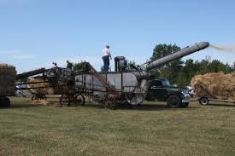



Reasons for Internal Migration – The Lowlands of Scotland
Reason 1: Effects of the Agricultural Revolution
Firstly, seasonal migration had been occurring in Scotland for years due to the constant pressure to move around came from a lack of stable employment/wage
The jobs created on lowland farms during the harvest season can explain why many moved around Scotland at this time
Secondly, a rapid population growth in the Lowlands prior to 1800 spread concern that there could be severe famine
Farming methods were altered and additional labour was hired, thus moving some of the agricultural workers
Thirdly, improvements in farming equipment meant less people were needed to work the land e.g. steam power led to threshing machines, steam ploughing & machine reaping. Diesel power led to trackers & combine harvester
E.G. 1840 it took 22 man-days to tend an acre of barley; by 1951 it had dropped to 3!
Consequently (and finally) the change in farming methods also resulted loss of work for a number of local industries – e.g. black smith who previously maintained the metal ploughs and shoed the horses
Displaced farm labourers headed for the nearest town in search of work and accommodation. By 1851, 15% of the population of Peebles-shire had made its way to Edinburgh.

Slide 56



Reasons for Internal Migration – The Lowlands of Scotland
Reason 2: Effects of Industrial Revolution
This was the rapid development of industry in towns /cites brought about by the introduction of machinery
A new middle class was created & due to this there was a growing demand for domestic help/jobs* in cities
The textile mills in Glasgow and Paisley where crying out for more workers & in Dundee the jute works*
Many migrated from the rural areas as they offered more opportunities for work
Furthermore, wage levels in the industrial sector were far higher than in agriculture, often as high as 50 per cent more*
However technology was also destroying the textile industry & jobs in numerous villages*
Local craftsmen could not compete with urban competition & many lost work & had to move to the towns in search of work
E.G. A powered loom (device designed to weave threads into cloth) reduced the demand for skilled weavers, lowering their wages, with some even losing their jobs as unskilled labours could do the work
Also many women and children were now able to be employed at mills, replacing the men as weavers*

Slide 57




Reasons for Internal Migration – The Lowlands of Scotland
Reason 3 – Improved Transport
Firstly, the development of transport links (railways, canals, road building) led to jobs & the opportunity to travel around Scotland finding work
Secondly, the railway branch lines eventually linked the north to south & allowing effective allowing fast & cheap travel for all
The result was people could now move from smaller communities to the large cities easily, increasing temporary migration
Railways also opened up the opportunity to move to England which was a good option for those who did not want to/could not go abroad
However… the development of the railways lines also enabled cheap factory goods to be travelled around the country – this effected local trades such as tailors & shoemakers as they could not compete with factory/mass produced prices
Traditional markets in rural areas were threatened by spread of railway lines – leading to migration due to failing businesses & lack of work/wages

Slide 58


Reasons for Internal Migration – The Lowlands of Scotland
Reason 4: Inability to go Abroad
Many Scots feared committing to long distance migration & chose not to move abroad
Some simply could not afford to migrate which led to many women, children & elderly staying behind
However some families and friends who had already left Scotland wrote back telling of the harsh conditions abroad – putting many Scots off
For these people who did not want to remain in Scotland England offered better wages & more professional jobs – especially after 1920s
Scottish farmers went down south to set up their farms – 1930 around 20% of farmers in Essex were Scots
We offered a variety skills not only on farms but also within the medical profession

Slide 59


Reasons for Internal Migration – The Lowlands of Scotland
Reason 5: Attractions of the Big City
We already know that the growing towns and cities offered more opportunities for work
However they also offered an escape from working long hours, with few holidays and for poor pay of those working on farms
For example a ploughman would rise at 5am & work until 6pm – although this was lowered to 10 hours after WWI
The big cities offered better wages, easier work in less harsh conditions than the land, but most importantly the ability for more leisure time – pubs, cinemas, dance halls & football grounds
This freedom in the evenings and weekends away from the employer was a huge attraction for many people
The prospect of a more varied social life and an end to the isolation of living on the land had a HUGE impact on society

Slide 60
And Finally…
Failure of the kelp & industry & Herring | Highland Clearances – thrown off land to make way for sheep | Potato famine – leading to malnutrition & starvation | Balmoralism – tourism to the Highlands. Types of jobs required changed
Social life & higher wages offered in towns/cities | Living in bothy/black house – poor living conditions | England offered higher wages & better opportunities in trades & professions | Over population of the Highlands – land too small to make a living. Dowry
Railways and cannel made moving much easier for people & goods | Industrialisation meant the towns/cities offered jobs in factories | Invention of new farming machinery = less jobs on farms | Could not afford to go to USA or were too scared
Notes:
See how many reasons pupils can guess using the pictures to help which explain why there was internal migration in Scotland

Slide 61



Pair & Share Task
Each pair will be given a coloured pen & have 60 seconds to write down reasons why the Scots migrated within Scotland
You will then move round the other groups & tick off their sheet the ones which you had remembered & add answers they don’t have
This will allow you share what you know, see how other groups word answers & ensure that we know at least 6 reasons!
Notes:
Give pairs/small groups a piece of blank paper an they will carousel around the class

Slide 62
Which are PUSH factors and which PULL factors?
Failure of the kelp & industry & Herring | Highland Clearances – thrown off land to make way for sheep | Potato famine – leading to malnutrition & starvation | Balmoralism – tourism to the Highlands. Types of jobs required changed
Social life & higher wages offered in towns/cities | Living in bothy/black house – poor living conditions | England offered higher wages & better opportunities in trades & professions | Over population of the Highlands – land too small to make a living. Dowry
Railways and cannel made moving much easier for people & goods | Industrialisation meant the towns/cities offered jobs in factories | Invention of new farming machinery = less jobs on farms | Could not afford to go to USA or were too scared
Notes:
See how many reasons pupils can guess using the pictures to help which explain why there was internal migration in Scotland

Slide 63
As a class what do we think are the 10 most important reasons for INTERNAL MIGRATION?

Slide 64
Exam Question Time…
How fully does Source A illustrate the reasons for internal migration by the Scots during the period of 1830 to 1930?
Use the source & recalled knowledge 9
ALL THAT YOU NEED TO DO IS:
Read each sentence carefully
Pick out 3-4 quotes which explain reasons for the internal migration of the Scots
Back up each quote with some background knowledge to answer the question – e.g. don’t quote it (3 marks max.)
Add in recall - up to 7 marks
Make a judgement – How Fully?? (2 marks max. if not e.g. fairly good explanation)

Slide 65

How Fully Question 1
How fully does Source A illustrate the reasons for internal migration by the Scots during the period of 1830 to 1930?
Use the source & recalled knowledge 9
Industrial Revolution meant goods were made cheaper in factories in towns – could not compete
New technology reducing need for workers
Allowed for easier, cheaper travel
Country life boring
RECALL:
Highland Clearances
Failure of Kelp & Fishing industries
New farming technology… etc.
Notes:
2011 specimen paper example

Slide 66
How Do I Layout Answer?
Introduction
Set in context – explain that the source ‘fairly well’ explains the reasons for the internal migration of the Scots
Then VERY briefly state what the source mentions & what it fails to
E.G. The source mentions the Highland Clearances, Balmoralism & development of the railways as reasons for internal migration however fails to mention the agricultural or industrial revolutions… etc.
Information from Source
Select at least three relevant points in the source
Develop each point in terms of the question – why does this help explain internal migration? You will have to put in recall to backup the quote.
(up to 3 marks available for points made from the source)
Information from Recall
Develop further points not made in the source that will support your answer that the source ‘to an extent’ explain all the reasons for internal migration
Notes:
66

Slide 67
Model Answer:
Source A ‘fairly well’ explains the reasons for the internal migration of the Scots.
Information from Source
The sources mentions…
The sources mentions…
The sources mentions…
Information from Recall
The source however fail to mention…
The source however fail to mention…
The source however fail to mention…
The source however fail to mention…
The source however fail to mention…
The source however fail to mention…
Notes:
67

Slide 68

How Fully Question 2
How fully does Source A illustrate the reasons for internal migration by the Scots during the period of 1830 to 1930?
Use the source & recalled knowledge 9
Try this one in pairs
Notes:
2014 – much easier than specimen paper

Slide 69
Read Through These Sources & See How Many Reason You Can Come Up With
4
..That Explain Why The Scots Emigrated
5-6
5

Slide 70

Evaluation…
Issue 1:
Reasons for Internal Migration of the Scots
I can give at least 9 detailed explanations as to why there was internal migration in Scotland?
I can explain both push & pull factors explain the movement?
I know how to structure a How Fully question & where I get the marks from?

