Slide 1
Higher Assignments

Slide 2
What do you have to do.
Select a research question or aim.
Conduct your own in-depth research.
Gather data.
Analyse your data.
Discuss your findings
Provide a conclusion.

Slide 3
How will you be assessed?
In school assessment – 90 minute exam.
You must prepare your assignment in advance.
You can bring into the exam 2 sides of A4 paper which will be submitted along with your written exam, these can contain notes, graphs, tables, quotes or other information relevant to your chosen research question.
This assignment makes up 33% of your over all grade!!!!

Slide 4
What will I do my assignment on?
Fieldwork based
Edinburgh - Study into shopping patterns
- Land use transect, comparison with Burgess model.
Dalkeith - Sphere of influence study
- Environmental quality survey
Research based
- Can be in relation to a topic of your choice.
- Must be controversial (i.e have clearly opposing arguments)
- you must find three or four CREDIBLE sources to base your assignment on.
- you must be able to critique these sources and present a conclusion of findings

Slide 5
How will my assignment be structured ?
Field work based
Introduction
Method
Findings
Discussion
Conclusion
Research based
Introduction
Method
Argument 1
Argument 2
Analysis
Conclusion

Slide 6
Option 1 – Study into shopping patterns in Edinburgh.
Possible aim – identify the reason for choice of shopping location in Edinburgh.
Methods – questionnaires, interviews, pedestrian counts.
Processing findings – Pie chart, graphs, maps, tables, bar graphs, quotes.

Slide 7
Possible questions from questionnaire:
1) How did you travel here today?
a) Bus b) car c) taxi d) walk e) tram
2) What are you shopping for today?
a) Clothes b) food c) electronics d) other

Slide 8
Option 2 – Comparison to Burgess model in Edinburgh
Possible aim – How does my chosen transect of Edinburgh differ from the Burgess model?
Methods – field sketching, photography, land use survey.
Processing findings – maps, transects, photographs,

Slide 9
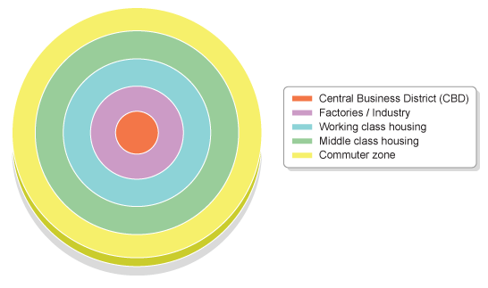
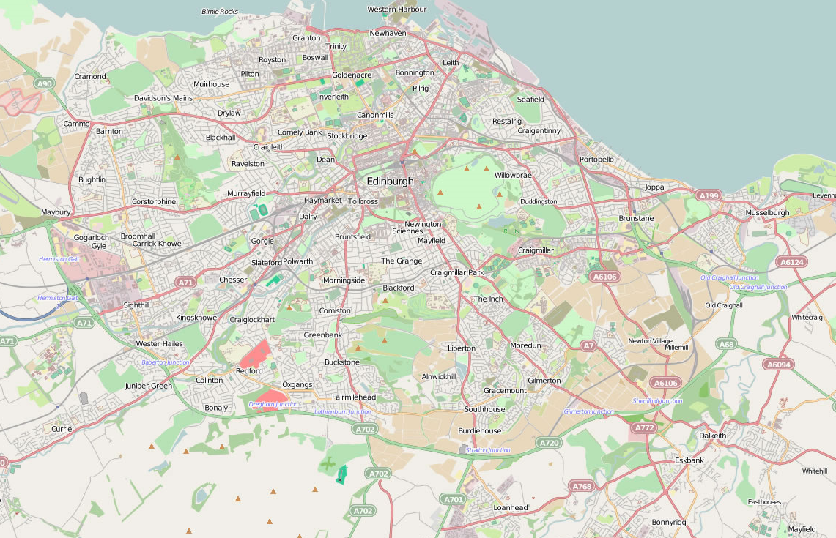
Burgess Model in comparison with Edinburgh cross section
Transect line

Slide 10
Option 4 – Sphere of influence study.
Possible aim – identify the variation in sphere of influence of the high and low order services in Dalkeith.
Methods – interviews, questionnaires, surveys
Processing findings – Pie chart, graphs, maps, tables, bar graphs, quotes.

Slide 11
Possible shops to include in study
High order:
Kilt Shop
BMW motor bike shop
Tattoo studio
Morrison's
Tesco
Low order:
News agent
Chip shop
Barbers

Slide 12
Sphere of influence

Slide 13
Option 5 – environmental quality survey
Possible aim – to identify the varying levels of environmental quality around Dalkeith (other)
Methods – conduct environmental quality surveys at a variety of locations. Photographs, field sketches.
Processing findings – Pie chart, graphs, maps, tables, bar graphs, quotes.

Slide 14
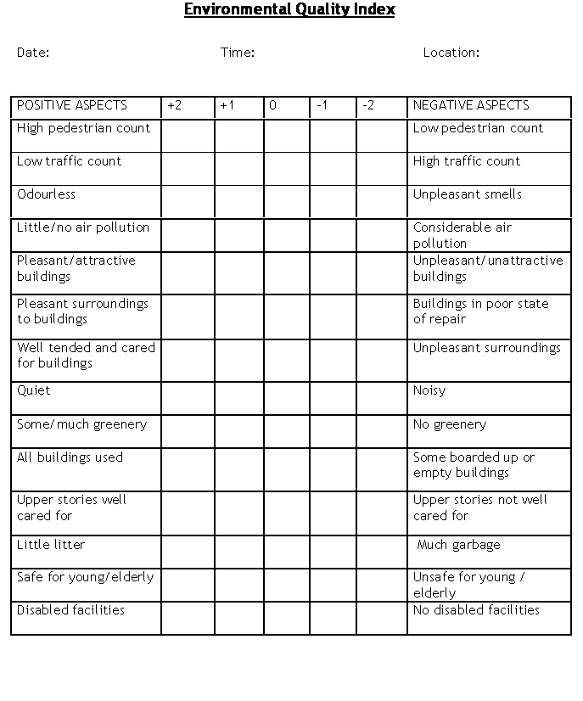

Slide 15
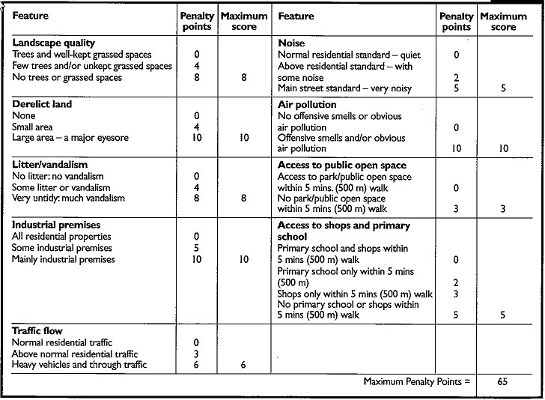

Slide 16
Option 6 – research based study
Can be in relation to a topic of your choice.
Must be controversial (i.e have clearly opposing arguments)
You must find two or three CREDIBLE sources to base your assignment on.
You must be able to critique these sources and present a conclusion of findings.

Slide 17
Data collection Day
All pupils will get one day of school time to collect data.
You could be based in school, Dalkeith or in Edinburgh with a Geography teacher.
The rest of your assignment will be completed at home in your own time!!!

Slide 18
Task – homework
Produce a detailed proposal for your assignment. You need to outline:
Key aims or questions
Where are you going to collect your data.
When are you going to collect the data?
What data collection methods are you going to use.
If using a questionnaire, environmental survey, interview, traffic count etc then hand in a completed example.
If research based, outline examples of sources that could be used.
Do you need to ask anybody's permission, if so who?
How will you process your data? e.g pie chart, bar graph, map etc.
Your completed proposal must be a minimum of on page of A4 paper and answer al of the key points above.

