Slide 1
WORLD ISSUES: Development in Africa
ESSAY 1:
Factor X affects African development more than any other. Discuss

Slide 2
Factors Affecting African Development:
Food And Water Shortages
SOCIAL
Health
Education
POLITICAL
Poor Governance
WAR & Conflict
ECONOMIC
DEBT
Trade Terms & Cash Crops

Slide 3
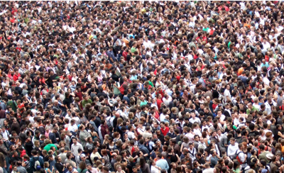
Factors Hindering Development
Many countries in Africa suffer from a combination of social, economic & political factors that hinder overall development
Although these factors can be identified separately they are interlinked, having an knock-on-effect on the others e.g. A bad government will lead to alack of social services like health care
Write three sentences to explain what you understand by the terms:
Political
Economic
Social
_____ means anything to do with ________.

Slide 4
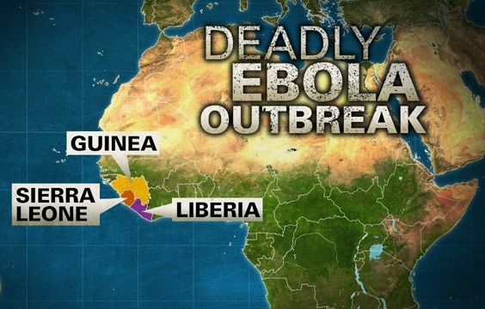
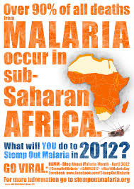
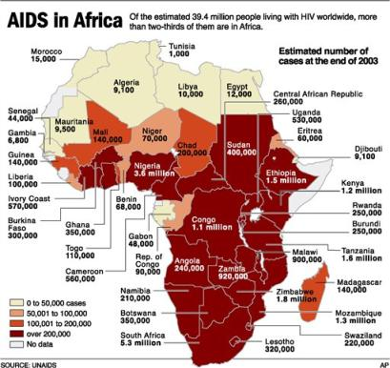
Factor 1: Poor Health Hinders Africa Development
EBOLA
MALARIA
Good HEALTH and HEALTH CARE are essential components of a developed country – WHY?
THINK: If a major epidemic broke out in Scotland (Ebola) how would this change Scotland?
HIV & AIDS

Slide 5
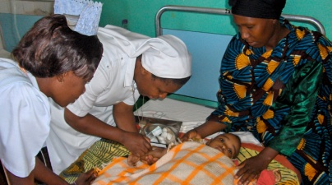
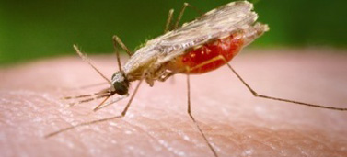
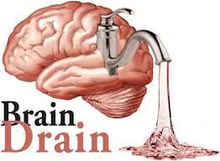
Factor 1: Poor Health Hinders Africa Development
Without a healthy work force it is not possible for the economy to function properly – not enough healthy workers
Family members also spend time caring for ill people and cannot work
Few African countries provide public (free) healthcare and those that do spend most of the financial resources helping to treat illness then prevention programs – immunisations, mosquito nets
Save the Child estimate almost 800 children die every day because their parents cannot afford to pay for medical treatment
Not only this but hospitals tend to be poorly resourced and staffed which means many health care professionals are attracted by conditions in more developed nations like the UK - leaving their country with a ‘Brain Drain’
In 2004 it was estimated that there were more doctors from Ghana working in New York and New Jersey than in the whole of Ghana

Slide 6
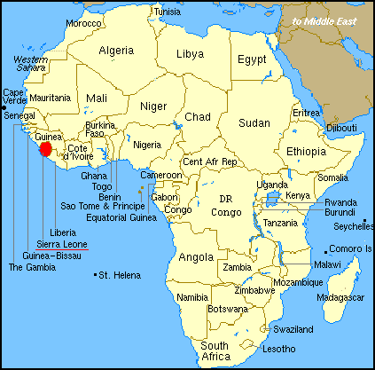
Factor 1: Poor Health Hinders Africa Development
What Do You Think Is The Biggest Indicator Of The State Of A Countries Health?
LIFE EXPECTANCY!!!
The average life expectancy in the UK is 78.5 years
WHAT DO YOU THINK THE LIFE EXPECTANCY IS IN SIERRA LEONE
45.3!!!

Slide 7
Factor 1: Poor Health Hinders Africa Development
Malaria is Africa’s biggest killer (900,000 deaths a year) caused by parasites transmitted by mosquito bites & leading to organ failure
88% of the worlds malaria deaths happen in Africa
This can be treated using drugs however for many people health care facilities are not always easily accessible and families cannot afford to travel to clinics
It is estimated that malaria accounts for economic losses amongst African countries totalling $12 billion per year as people are too sick to work
Many children who survive suffer later in life from brain damage
1. MALARIA

Slide 8
Factor 1: Poor Health Hinders Africa Development
The WHO (World Health Organisation) estimates that malaria accounts for 20-50% of hospital admissions in African countries. It accounts for 40% of all hospital resources
If malaria were to be reduced then money could be spent on other vital resources such as education (e.g. $760 million was spent on malaria treatment in 2006 alone)
In Uganda anti-malaria sprays have been used however this has caused problems for farmers who specialise in growing organic fruits and vegetables – therefore the farmer losies sales
1. MALARIA
How Does Malaria Affect African Development?

Slide 9
Factor 1: Poor Health Hinders Africa Development
Sexual health information & contraception can be difficult to find which may explain the serve ongoing problem
There is an HIV/Aids epidemic in Africa – over 70% of the 35 million people infected live in Africa! WHY?
An estimated 25 million+ adults & children are living with the condition and it kills 1.5 million people a year – 6300 a day!!
HIV/AIDS has left behind 11 million orphaned African children – Swaziland there are 75,000
Treatment is expensive and only 3% receive the treatment they need
Food is very important for HIV/Aids sufferers as malnutrition increases HIV progress. Without good food, the anti-retroviral drugs used to treat the condition are not as effective
2. HIV & AIDS
The HIV virus damages the immune system - transmitted by direct exchange of bodily fluids e.g. unprotected sex, blood transfusion & maternal transition

Slide 10
Factor 1: Poor Health Hinders Africa Development
In addition, by 2020, it is estimated that HIV/Aids will kill 20% of southern Africa’s farm workers – this will considerably effect the long term food availabity
Therefore, it is understandable why the disease could slash the wealth of some African countries by as much as 20%
For example, in Botswana which has the world’s second highest incidence of HIV with 36.5% of its population affected, faces a rapid increase in extreme poverty amongst its poorest
2. HIV & AIDS
How Does HIV/Aids Affect African Development?

Slide 11
Factor 1: Poor Health Hinders Africa Development
Many children in Guinea, Liberia and Sierra Leone have lost one or both parents to Ebola since the start of the outbreak in West Africa
Schools have also had to shut in places like Liberia for the last 7 months
Several West African countries have high numbers of expatriate workers in critical sectors of the economy and the fear of Ebola has caused almost a mass movement of foreigners back to home
Investment projects have stalled - in Liberia, a World Bank contract for the construction of a road between Liberia and Guinea, expected to facilitate trade, has been suspended as the Chinese contractor pulled their worker out
Ebola is an infectious & generally fatal disease which causes fever & severe internal bleeding, is spread through contact with infected body fluids
3. EBOLA

Slide 12
Factor 1: Poor Health Hinders Africa Development
Border closures by countries like Ghana have a significantly adverse effect on trade in the region
Airlines, hotels and travel companies are expected to suffer reductions in revenues. Gambia, which derives 16% of its GDP from tourism, is perhaps the worst affected in the region. The start of the tourism season last year saw a significantly lower number of tourists than in previous years with an anticipated 50-60% drop
In a country where half the population live below the poverty line and are dependent on this industry for their livelihood, we can expect a worsening of their conditions
Another sector badly hit by the crisis is theagriculture sector. In Guinea, Sierra-Leone and Liberia, there have been disruptions due to farmers staying away from farmlands and market places to the detriment of the agriculture sector
How Does Ebola Affect African Development?
3. EBOLA

Slide 13
Factor 1: Poor Health Hinders Africa Development
CONSEQUENCES OF POOR HEALTH ON AFRICA:
Many HIV/AIDs sufferers are young & the main income earners in a family – when they die their family is left without an income
It is estimated that malaria accounts for economic losses amongst African countries totalling $12 billion per year as people are too sick to work (less people working – the less paying taxes)
Malaria accounts for 40% of all hospital resources - could be spent on other vital resources such as education
Investment projects have stalled due to Ebola – foreign contractors pulled their workers out
Airlines, hotels and travel companies are expected to suffer reductions in revenues due to Ebola

Slide 14
Factor 1: Poor Health Hinders Africa Development
CONSEQUENCES OF POOR HEALTH ON AFRICA:
Many people stay at home to look after sufferers – again depriving the family of an income
Education is affected: schools shut down to stop spread of Ebola; teachers may be ill; children also may become carers or forced into work if their parents are ill
HIV/AIDS has left behind 11 million orphaned African children
Health care professionals are attracted by conditions in more developed creating a ‘Brain Drain’
Expatriate workers in critical sectors of the economy and the fear of Ebola has caused almost a mass movement of foreigners back to home
By 2020, it is estimated that HIV/Aids will kill 20% of southern Africa’s farm workers –long term effects on the food available

Slide 15
Factor 1: Poor Health Hinders Africa Development
Why Is There Such Bad Health In Africa…?
Poor Education; (social)
Debts; (economic)
Conflict; (political)
Corruption Governments… (political)
For this question you would compare several factors in importance
Evaluate The Extent To Which A World Issue You Have Studied (The Lack Of Development In Africa) Has Been Caused By Social Problems (Poor Health) 12 MARKS
Notes:
It is not the main factor affecting health

Slide 16
Paragraph 1: Poor Health Hinders Africa Development
Questions:
What is a good indicator of the health within a country? Give an example to compare the UK to Africa.
What might explain the difference between these areas? So how does Africa differ from the UK in terms of health?
What long term problems are there with health care professionals?
How does Malaria affect Africa? Give at least 2 examples; 1 from a specific country
How does HIV/AIDs affect Africa? Give at least 2 examples; 1 from a specific country
How does Ebola affect Africa? Give at least 2 examples; 1 from a specific country
Overall, what do you causes poor health in Africa?
Notes:
Life expectancy; free health care; brain drain;

Slide 17
Paragraph 1: Poor Health Hinders Africa Development
TASK:
‘With Reference To A World Issue You Have Studied (lack of development in Africa) Analyse The Factors Which Have Caused The Issue.’ 12 Marks
Once I have shown you how to use the marking grid your task is to use it and try to mark for yourself an answer to the above question
As you will see there are many different ways to get your 12/12
You will then attempt to make a plan that goes along with answer – this will help you then have a go at writing your own paragraph using the marking grid & P.E.E.

Slide 18
Marking Grid – there are so many different ways to gain your marks
‘With Reference To A World Power You Have Studied Analyse The Factors Which Have Caused The Issue.’ 12 Marks
KU = 8 marks
Analysis/evaluation = 4
 | 1 Mark | 2 Marks | 3 Marks | 4 Marks
Knowledge | 1 relevant description | 2 relevant descriptions OR 1 detailed relevant description | 1 relevant description AND 1 detailed relevant description | 2+ detailed relevant description
Explanation or Example | 1 basic explanation from KU from above OR example | 2 basic explanation from KU from above OR 1 detailed explanation | 1 detailed explanation AND 1 basic explanation | 2+ fully explained AND Examples
Analysis/ Evaluation (usually at the end) | 1 analytical OR Evaluative comment | 1 analytical/Evaluative comment which is justified OR 2 basic analytical/ evaluative comment | 1 analytical/ Evaluative comment which is justified AND Examples | 1 extended analytical/ Evaluative comment which is justified
Notes:
Way 1: basic

Slide 19
Paragraph 1: Poor Health Hinders Africa Development
TASK: P.E.E.
‘With Reference To A World Issue You Have Studied (lack of development in Africa) Analyse The Factors Which Have Caused The Issue.’ 12 Marks
One way in which poor health has affected the development of Africa can be seen through the _______ epidemic.
The means that __________ (describe what problems this creates)
For example in ______________ (give an example from a country)
Therefore it can be argued that ____ is a more important factor in understanding the lack of development in Africa in comparison to ___ & ___ because _________
= 2 marks (1x description; 1x example)
= 4 marks (1 x detailed description; 1x detailed explanation/examples)

Slide 20
Marking Grid – there are so many different ways to gain your marks
‘With Reference To A World Power You Have Studied Analyse The Factors Which Have Caused The Issue.’ 12 Marks
KU = 8 marks
Analysis/evaluation = 4
 | 1 Mark | 2 Marks | 3 Marks | 4 Marks
Knowledge | 1 relevant description | 2 relevant descriptions OR 1 detailed relevant description | 1 relevant description AND 1 detailed relevant description | 2+ detailed relevant description
Explanation or Example | 1 basic explanation from KU from above OR example | 2 basic explanation from KU from above OR 1 detailed explanation | 1 detailed explanation AND 1 basic explanation | 2+ fully explained AND Examples
Analysis/ Evaluation (usually at the end) | 1 analytical OR Evaluative comment | 1 analytical/Evaluative comment which is justified OR 2 basic analytical/ evaluative comment | 1 analytical/ Evaluative comment which is justified AND Examples | 1 extended analytical/ Evaluative comment which is justified
Notes:
Way 2: quicker but more difficult - 2/3 fully explain escriptions and exanations of how this factor caused the issue, with examples = 8 makrs PLUS 2x justified with examples mini conlsuion of judgemtn/comparison

Slide 21
Paragraph 1: Poor Health Hinders Africa Development
TASK: P.E.E.
‘With Reference To A World Issue You Have Studied Analyse The Factors Which Have Caused The Issue.’ 12 Marks
One factor which has caused a lack of development in Africa can be seen through the problems created by poor health.
This can be seen though illness like malaria, HIV/Aids and Ebola that have stopped many going out to work & providing for their families. It also affects close family relatives as they go on to care for those ill and cannot go out to work or attend school which will increase the chances of staying in long-term poverty. Less people working means less taxes for the government, and therefore there is less money to put towards development.

Slide 22
Answer ( Cont.)
For example 88% of the worlds malaria deaths happen in Africa and it is estimated that malaria accounts for economic losses amongst African countries which totals $12 billion per year as people are too sick to work. Most malaria cases are found in the poorest sub-saharan countries such as Chad.
Therefore it can be argued that health is an important factor in understanding the lack of development in Africa because it affects not only those ill or their families but also the specific countries economy as less work is being done. Less work means less G.D.P, and therefore the finds it difficult to further develop. However, poor health is something that could be tackled through good governance and many of the countries with the poorest health, e.g. Zimbabwe which in 2009 had a severe outbreak of cholera, coincide with corrupt governments

Slide 23
Paragraph 1: Poor Health Hinders Africa Development
TASK: P.E.E.
‘With Reference To A World Issue You Have Studied Analyse The Factors Which Have Caused The Issue.’ 12 Marks
One factor that has caused a lack of development in Africa can be seen through the problems created by poor health. (knowledge)
This can be seen though illness like malaria, HIV/Aids & Ebola (1 relevant knowledge/example mark) that have stopped many going out to work & providing for their families. (1 basic explanation marks) It also affects close family relatives as they go on to care for those ill and cannot go out to work or attend school which will increase the chances of staying in long-term poverty. (1 detailed explanation – 2 marks) Less people working means less taxes for the government, and therefore there is less money to put towards development. ( ! Mark detailed explanation).
For example 88% of the worlds malaria deaths happen in Africa (1 example - 1 mark) and it is estimated that malaria accounts for economic losses amongst African countries totalling $12 billion per year as people are too sick to work (1 detailed explanation with examples - 2 mark)
Therefore it can be argued that health is an important factor in understanding the lack of development in Africa because it affects not only those ill or their families but also the specific countries economy as less work is being done. However, poor health is something that could be tackled through good governance (1 Analytical/Evaluative comment – 1 marks) and many of the countries with the poorest health, e.g. Zimbabwe who in 2009 had a severe outbreak of cholera, coincide with corrupt governments (1 detailed explanation with examples - 1 mark)
= 10 MARKS

