Slide 1
WORLD ISSUES: Development in Africa
ESSAY 1:
Factor X affects African development more than any other. Discuss.

Slide 2
Factors Affecting African Development:
Food And Water Shortages
SOCIAL
Health
Education
POLITICAL
Poor Governance
WAR & Conflict
ECONOMIC
DEBT
Trade Terms & Cash Crops

Slide 3
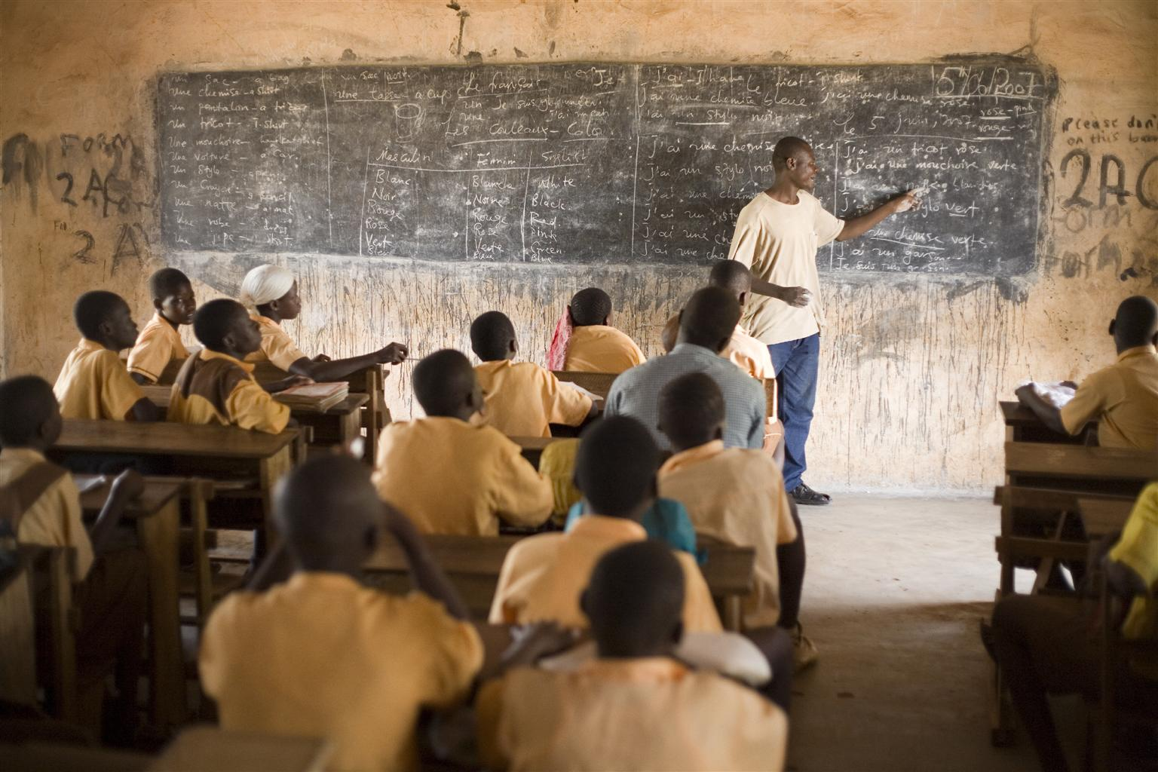
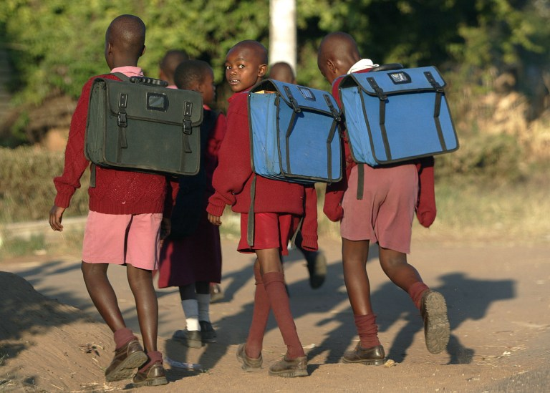
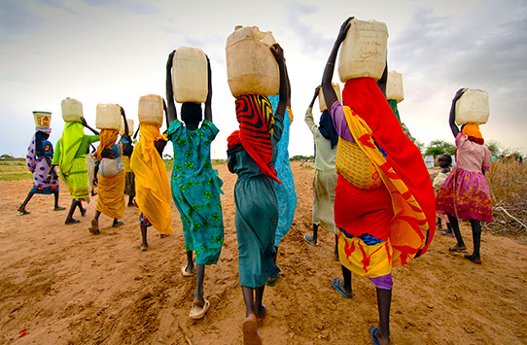
Factor 2: Education Hinders Africa Development
Classroom Experience
Good EDUCATION an essential component of a developed country – WHY?
Enrolment Numbers
Inequalities For Girls

Slide 4
Factor 2: Education Hinders Africa Development
The education a child experiences in Africa is very different from a child in Scotland!
Without doubt educating a nation is the key to ending the poverty cycle HOWEVER access to primary education is an ongoing issue in many African countries
One of the United Nations Millennium Development Goals is to achieve Universal Primary Education - "Educating children gives the next generation the tools to fight poverty and prevent disease, including malaria and AIDS.“
Education is also heavily linked to better paid work as qualifications allow access to higher-paid jobs
This has a huge knock-on effect for development – a skilled and educated workforce is required for a country to move toward development e.g. doctors, teachers, engineers etc.

Slide 5
Factor 2: Education Hinders Africa Development
With African high birth rates it is difficult to provide enough school places
Like health care education is not free in every country and for those that are free there are still problems – in Uganda although secondary education is paid for by the state parents still need to pay for food; uniforms; textbooks which many cannot afford
This may explain the high drop out rates – 72% in Chad
For those that do attend schools they are faced with a lack of basic facilities:
Many schools lack properly trained teachers, overcrowded classrooms (40-70 kids!), lack of teaching resources due to lack of funding
Classroom Experience

Slide 6
Factor 2: Education Hinders Africa Development
Malawi less than 60% of teachers have undergone teacher training – this may help to explain why 1 in 6 people here cannot read or write
This creates a cycle of poverty as illiteracy rates are highest in countries with the highest level of poverty - For example in Ethiopia adult literacy rates are as low as 42% (less than half!)
In Africa enrolment levels are the lowest in the world – with 33 million children not attending school
Enrolment levels for primary school even worse for girls, (only 15% students are girls in Uganda) particularly in rural areas with very few going further into secondary schools
Enrolment Numbers

Slide 7
Factor 2: Education Hinders Africa Development
For example, in Somalia, only 12% of boys & 7% of girls attend primary school
Women are more likely to denied an education as they are expected to care for family members and undertake house hold burdens such as fetching water
It is particularly important to educate women as they will then be more likely to protect themselves from HIV/AIDs and have less children – the children she does have will be better nourished & educated
However there has been major improvement over the last 15 years with a number of countries, including Burundi, the Democratic Republic of the Congo, Ghana, Ethiopia, Malawi and Mozambique, having experienced explosive growth in primary school enrolment following the elimination of fees!
Inequalities For Girls

Slide 8
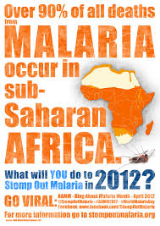
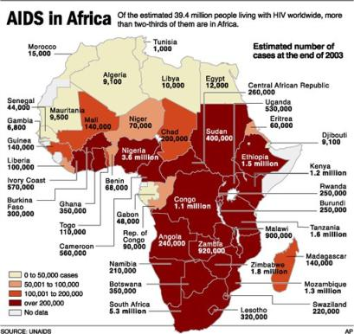
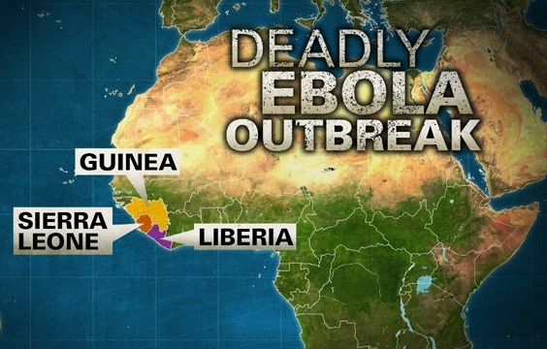
Factor 2: Education Hinders Africa Development
CONSEQUENCES OF POOR EDUCATION ON AFRICA:
Education linked to better paid work and breaks the cycle of poverty
E.G. Illiteracy rates are highest in countries with the highest level of poverty
It is important to educate women to help protect them from HIV/AIDs and have less children
It is important to have a skilled and educated workforce in order for a country to move toward development e.g. doctors, teachers, engineers etc.

Slide 9
Factor 2: Education Hinders Africa Development
Why Is There Such Poor Education In Africa…?
Poor Health; (social)
Debts; (economic)
Conflict; (political)
Corruption Governments… (political)
For this question you would compare several factors in importance
Evaluate The Extent To Which A World Issue You Have Studied (The Lack Of Development In Africa) Has Been Caused By Social Problems (Poor Health, poor education ) 12 MARKS
Notes:
It is not the main factor affecting developemnt

Slide 10
Factor 2: Education Hinders Africa Development
Questions:
How does Africa differ from the UK?
What effect does this have on the quality of teaching?
What are enrolment numbers like in Africa?
Why are there inequalities in education for women? & Why is education important for women?
What is the knock on effect does poor education have on Africa?
Overall, what do you think causes poor education in Africa?

Slide 11
Marking Grid – there are so many different ways to gain your marks
‘With Reference To A World Power You Have Studied Analyse The Factors Which Have Caused The Issue.’ 12 Marks
KU = 8 marks
Analysis/evaluation = 4
 | 1 Mark | 2 Marks | 3 Marks | 4 Marks
Knowledge | 1 relevant description | 2 relevant descriptions OR 1 detailed relevant description | 1 relevant description AND 1 detailed relevant description | 2+ detailed relevant description
Explanation or Example | 1 basic explanation from KU from above OR example | 2 basic explanation from KU from above OR 1 detailed explanation | 1 detailed explanation AND 1 basic explanation | 2+ fully explained AND Examples
Analysis/ Evaluation | 1 analytical OR Evaluative comment | 1 analytical/Evaluative comment which is justified OR 2 basic analytical/ evaluative comment | 1 analytical/ Evaluative comment which is justified AND Examples | 1 extended analytical/ Evaluative comment which is justified
Notes:
Way 1: basic

Slide 12
Marking Grid – there are so many different ways to gain your marks
‘With Reference To A World Power You Have Studied Analyse The Factors Which Have Caused The Issue.’ 12 Marks
KU = 8 marks
Analysis/evaluation = 4
 | 1 Mark | 2 Marks | 3 Marks | 4 Marks
Knowledge | 1 relevant description | 2 relevant descriptions OR 1 detailed relevant description | 1 relevant description AND 1 detailed relevant description | 2+ detailed relevant description
Explanation or Example | 1 basic explanation from KU from above OR example | 2 basic explanation from KU from above OR 1 detailed explanation | 1 detailed explanation AND 1 basic explanation | 2+ fully explained AND Examples
Analysis/ Evaluation | 1 analytical OR Evaluative comment | 1 analytical/Evaluative comment which is justified OR 2 basic analytical/ evaluative comment | 1 analytical/ Evaluative comment which is justified AND Examples | 1 extended analytical/ Evaluative comment which is justified
Notes:
Way 2: quicker but more difficult - 2/3 fully explain escriptions and exanations of how this factor caused the issue, with examples = 8 makrs PLUS 2x justified with examples

Slide 13
Factor 2: Education Hinders Africa Development
TASK: Use The Plan To Write A Paragraph
‘With Reference To A World Issue You Have Studied Analyse The Factors Which Have Caused The Issue.’ 12 Marks
Start with : “One factor that contributes to the lack of development in Africa poor education.”
Use the information from your answers to construct a knowledge/explanation/example answer on how poor education affects African development:
Explain why education is important
Explain why this is not happening through looking at the classroom experience with examples
Explain why this is not happening through looking at the enrolment & inequalities for girls with examples
Therefore it can be argued that poor education can be linked to poor health because

Slide 14
Factor 2: Education Hinders Africa Development
TASK: Compare You Paragraph To This One
‘With Reference To A World Issue You Have Studied Analyse The Factors Which Have Caused The Issue.’ 12 Marks
One factor that contributes to the lack of development in Africa poor education.
Education is important because it gives the next generation the tools to fight poverty & importantly disease. Not only this but a skilled and educated workforce is needed to develop the countries infrastructure e.g. Doctors; teachers & engineers. (Analytical)
In Africa education is not always free, and for those that are lucky enough to attend there are still problems as parents still need to pay for food; uniforms; textbooks which many cannot afford. (knowledge) This may explain the high dropout rates , for example72% in Chad! (example)
In Africa enrolment levels are the lowest in the world. (knowledge) Women are more likely to denied an education as expected to care for family members. (explanation)This is particularly important tin the development of Africa as educating women will then be more likely to protect themselves from HIV/AIDs. (explanation)
Therefore it can be argued that poor education can be linked to poor health because many cannot attend school as they are either ill themselves or caring for family members – especially women. If Africa were better educated they could possibly help reduce the health problems they encounter for example through birth control. (Evaluation)

