Slide 1
An Evaluation Of The Reasons For Changing Attitudes To Immigration
Prejudice And Racism
New/Old immigrants
This Explains Changing Attitudes Towards Immigration Because…
Immigration Acts
How does this explain racism changing attitudes?
Isolationism & The First World War
‘One Explanation Of Why Attitudes Changed Towards Immigration Was…
Competition
Division within America
How does this explain why WWI changed attitudes?
Casualties
How does this explain why WWI changed attitudes?
Fear Of Revolution
Russian Revolution
Strikes
Scapegoat
You must explain why each point you make is related to the question:
‘This Explains Changing Attitudes Towards Immigration Because…
‘One Explanation Of Why Attitudes Changed Towards Immigration Was…
Social
Economic

Slide 2
Issue 1
An Evaluation Of The Reasons For Changing Attitudes To Immigration
Factor 1: Prejudice And Racism
Factor 2: Isolationism & The First World War
Factor 3: Economic Fear
Factor 4: Social Fear
Factor 5: Fear Of Revolution
AIMS OF ESSAY:
To understand why hostility towards immigration grew in the USA
To explain why the American public supported immigration restriction

Slide 3
Aims Paragraph 1:
To Understand The Reasons Why Americans Feared A Communist Revolution In The USA
Have the background knowledge & argument to write your third paragraph on the influence ‘Fear of Revolution’ had on changing attitudes to immigration

Slide 4
PLAN FOR PARAGRAPH Revolution Changing Attitudes
1. Start with an Opening Argument e.g. state there is a link between the isolated factor & the question
2. Put in Knowledge – discuss why Americans were worried about immigrants from Russia post 1917 bringing with them
3. Put in Analysis – explain why America is anti-communist
4. Knowledge – discuss how fear of revolution was really sparked
5. Analysis – explain what impact this had on American people & politicians
6. Knowledge – discuss numbers in America/was there a real problem?
7. Analysis – explain what this allowed politicians to do
8. Evaluation – make a judgement: conclude that impacted politicians attitudes more than the peoples
Read Through Paragraph 5 On Handout

Slide 5
Example Paragraph

Slide 6
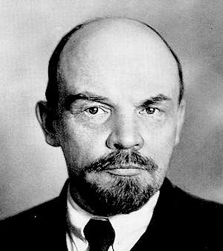
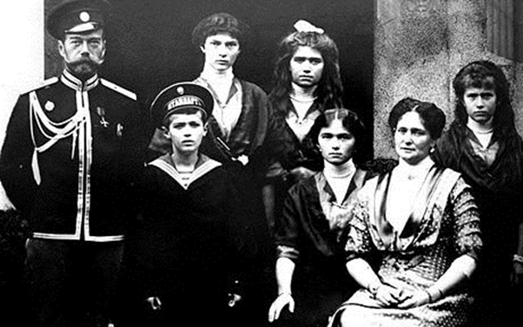
The Russian Revolution of 1917
During the final phase of WWI, a revolution took place in Russia
Tsar Nicholas II and his family were murdered in 1918
Under the leadership of Vladimir Lenin, the Bolsheviks replaced Russia’s traditional monarchy with the world’s first Communist state
The Russian Empire was transformed into the USSR (Union of Soviet Socialist Republics) by 1924
Lenin set about destroying capitalism and replacing it with a socialist system where the huge gap between rich and poor would be closed

Slide 7
What Is Communism?
Communists believe that the capitalist system is damaging to the interests of the masses
That workers must unite and overturn it by revolutionary means
The wealth of the nation should be fairly distributed so that workers can share the wealth created by their labour = creating a classless society
They also believe in the state ownership of all land, natural resources and industry = no private ownership
The hardening of American immigration policy can be explain through the fear of Communism being brought to their shores by New Immigrants

Slide 8
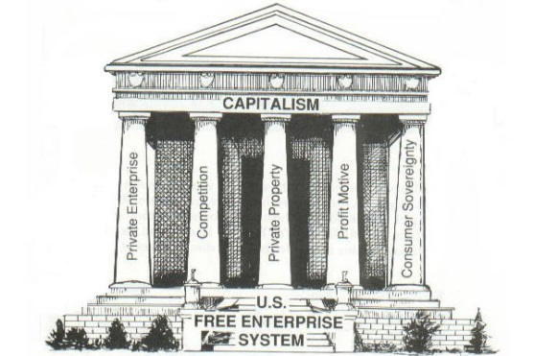
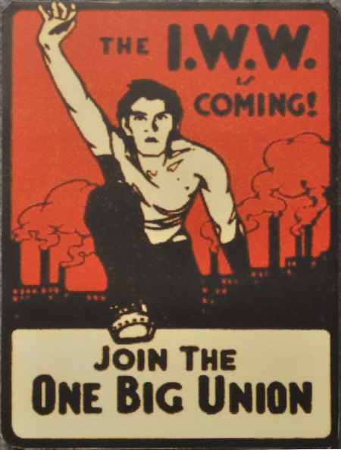
America & Communism?
Communist ideas are the exact opposite of what most Americans believe in – free enterprise, competition and hatred of government interference
As ‘New Immigrants’ from Russia continued to arrive in large numbers following the First World War this created a fear that they were also bringing with them the politics of murder and revolution
Following WWI, many Americans were alarmed by the pro-Russian leanings of new organisations with the country…
The International Workers of the World (the I.W.W. or Wobblies) and the ‘American Socialist Party’ were well know objectors to WWI, and to the minds of many Americans therefore, unpatriotic. This led them open to attack
Any activity associated with them was suspicious

Slide 9
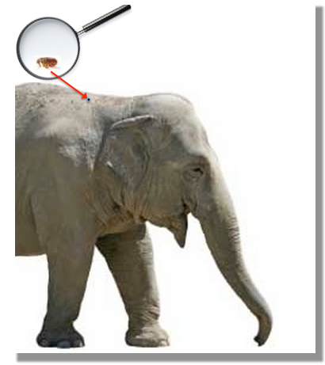
The Red Scare
It is estimated that there were over 150,000 anarchists or communists in the USA in 1920 which represented only 0.1% of the overall population of the USA
One journalist said that the “whole lot were about as dangerous as a flea on an elephant"
Despite this, many Americans were terrified of a communist revolution in the USA like that in Russia – this quickly transformed into a post war ‘RED SCARE’
There was an almost irrational fear of communism, anarchism and socialism
This led to further intolerance and suspicion towards immigrants and convinced many Americans to demand that action be taken to stop the flow of revolutionaries into the country

Slide 10
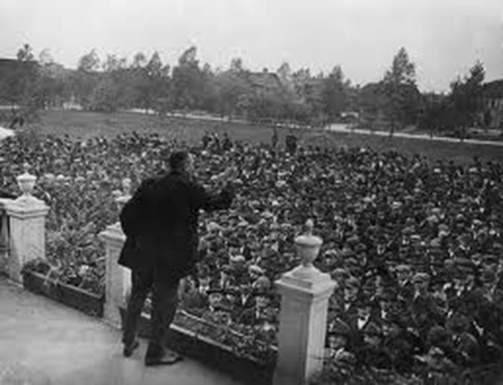
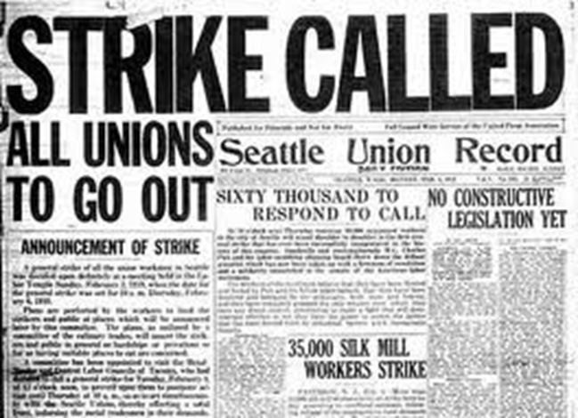
STRIKE!
Following WWI, a series of strikes seemed to confirm the threat. They led many to believe that a revolution was imminent
On 21st Jan 1919 35,000 shipyard workers in Seattle went on strike. By February 6th this increased to 60,000!
Despite the absence of any violence or arrests, the strikers were immediately labeled as ‘Reds’ and were charged with trying to incite revolution
Seattle Mayor Ole Hansen, blamed the Wobblies…
Violent strikes and riots soon followed in other industries such as the textile, railroad, steel and coal industries

Slide 11
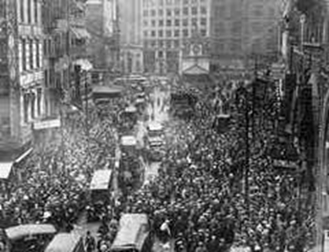
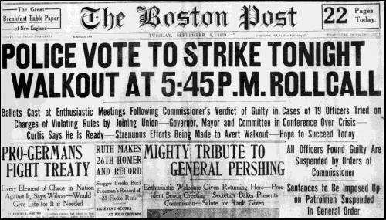
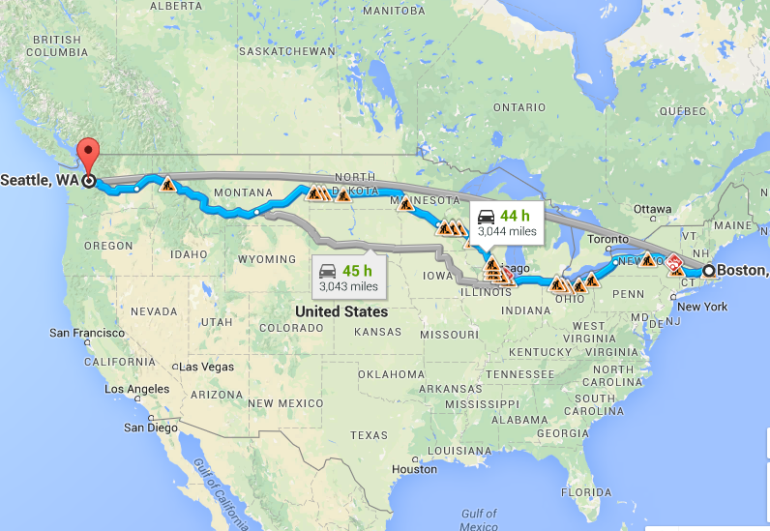
Nation Wide Strikes
The press reported that these strikes were "conspiracies against the government", and “plots to establish Communism“ – further creating this idea of a ‘RED SCARE’
On September 9th 1919, the Boston police force went on strike
A panic that "Reds" were behind the strike took over Boston & the policemen were called “agents of Lenin”
On September 13, Police Commissioner Edwin Curtis announced that the striking policemen would not be allowed to return and that the city would hire a new police force, effectively ending the strike!

Slide 12
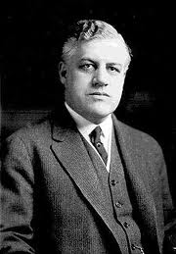
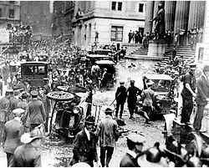
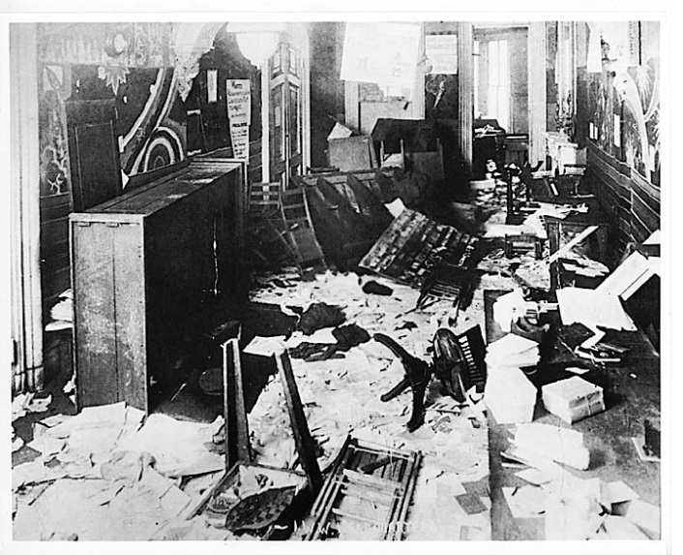
The Palmer Raids
In April 1919, police authorities discovered a plot for mailing 36 bombs to prominent officials
On June 2nd 1919 in eight cities, 8 bombs exploded at the same hour
One target was the Washington, D.C., house of U.S. Attorney General Palmer
This led to greater fear of communists and anarchists & hardened political attitudes against immigrants
This convinced US Attorney-General Mitchell Palmer that something had to be done & he pledged to hunt down all revolutionaries

Slide 13
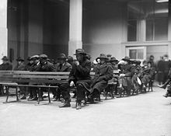
The Palmer Raids
1st January 1920, 6000 ‘aliens’ were rounded up by the Justice Department and imprisoned or expelled from the country
Many were detained for long periods of time without formal arrest
5 elected members of the New York State assembly were prevented from taking their seats
Immigrants from Southern & Eastern Europe were used as scapegoats and blamed for the growth of communism
The Palmer Raids showed that WASP America felt threatened by the arrival of new political ideas & show further isolate themselves – THIS SHOWS THE IMPORTANCE OF RACISM & PREJUDICE ATTITUDES IN CHANGING ATTITUDES TO IMMIGRATION!

Slide 14
PLAN FOR PARAGRAPH Revolution Changing Attitudes
1. Start with an Opening Argument e.g. state there is a link between the isolated factor & the question
2. Put in Knowledge – discuss why Americans were worried about immigrants from Russia post 1917
3. Put in Analysis – explain why America is anti-communist
4. Knowledge – discuss how fear of revolution was really sparked
5. Analysis – explain what impact this had on American people & politicians
6. Knowledge – discuss numbers in America/was there a real problem?
7. Analysis – explain what this allowed politicians to do
8. Evaluation – make a judgement: conclude that impacted politicians attitudes more than the peoples
Read Through Paragraph 5 On Handout

Slide 15
OPENING ARGUMENT
It can be argued that during the 1920s many WASPS changed their attitude towards immigrants as they feared their political beliefs and believed they might start a revolution in the U.S.A

Slide 16
FEAR OF REVOLUTION
KNOWLEDGE 1
What is Communism & Why would WASPS be against it?
Communist ideas are the exact opposite of what most Americans believe in e.g…
ARGUMENT 1
*It can be argued that the Bolshevik Revolution of 1917 in Russia creating the worlds first communist state frightened capitalist America and led to hostility towards new types of immigrants because...
... Murder & revolution

Slide 17
FEAR OF REVOLUTION
KNOWLEDGE 2
Why were fears made worse?
Organisation of groups
Give basic details of the strikes/bombings
ARGUMENT 2
It can be argued that strikes and civil unrest within America seemed to confirm the threat of a communist revolution taking place within the USA.
This lead to what 2 things happening?
... Demand for change & Palmer Raids
Notes:
Demand for change & raids

Slide 18
FEAR OF REVOLUTION
KNOWLEDGE 3
In reality why did they not really have anything to worry about?
X% in America
As a journalist said “the whole lot (communists) were about as dangerous as a flea on a elephant”
ARGUMENT 3
*It can be argued the Red Scare was created as a X to blame to get rid of all groups that did not believe in the American Dream e.g. ‘new immigrants’

Slide 19
FEAR OF REVOLUTION
Evaluation
Overall, fear of a revolution was an important factor in panicking the government and politicians against new immigrants however many ordinary Americans had taken part in these strikes to improve their lives and so this was a less important factor in changing attitudes towards immigration

