Slide 1
WORLD ISSUES: Development in Africa
ESSAY 2:
The Success Of International Organisations In Resolving Problems in Africa

Slide 2
Role & Effectiveness Of International Organisations In Attempts To Resolve The Issue
SUCCESSFUL
European Union (EU)
Non-Government Organisation (NGO)
Bilateral Aid From UK
African Union
(AU)
UNSUCCESSFUL
United Nations (UN)

Slide 3
Factor 3: African Union has resolved Africa’s Problems?
Background African Union:
Founded in 2002 to replace the Organisation of African Unity (OAU) – Morocco is now the only African state that is not a member
Its aim is to help secure African democracy; human rights; sustainable economy & in doing so bring an end to conflict
They view peace & security as essential elements in creating development & a united Africa
If there is conflict within an African Nation the AU will launch a military response usually to help the citizens
In terms of helping the economy the AU works to try to ensure fair trade takes place & in the future the AU is looking to implement a single currency for the whole of Africa

Slide 4
Factor 3: African Union has resolved africa’s problems?
WHY IMPORTANT?
The Money Spent On Weapons & Soldiers Could Have Been Spent Elsewhere On Vital Services Like Health Care & Development Programs
Annually Civil War Costs On Average Africa $18 Billion
AU Estimated That Corruption Cost Africa $148 Billion A Year & 50% Of Tax Revenues Are ‘Lost’
Many Emigrate Abroad - Many Of Whom Are The Skilled And Educated The People These Countries Need!
Heavy Reliance On One/Two Cash Crops Is Not Sensible As It Creates A Single Primary Export
Over 9 Million Refugees Since 2000 - Hindering The Next Generation With A Lack Of Consistent Education
Reduces Tourism & Foreign Investment

Slide 5
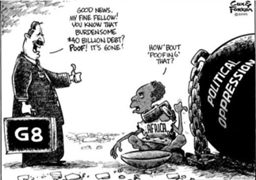
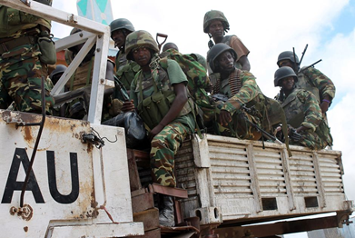
Factor 3: African Union has resolved Africa’s Problems?
Africa’s Real Problems
‘Democracy, Elections & Governance Charter’
AU Military Force

Slide 6
Factor 3: African Union has resolved Africa’s Problems?
SUCCESS
The AU has seen some success over the last 10 years:
Now as a matter of routine & in accordance with the 2007 ‘Democracy, Elections & Governance Charter’ AU send in observer missions to all member countries to cover elections to try to deal with corruption & dishonesty
This has resulted in a fall in conflicts & rise in successful elections
For example; elections in 2015 saw peaceful hand overs of power in both Nigeria & Lesotho
Although Boko Haram did attempt to disrupt the election by attacking voting centres - killing 41 people in Nigeria!

Slide 7
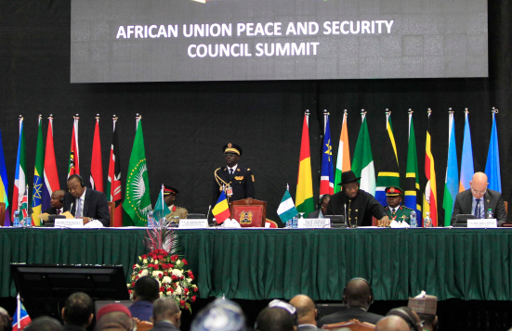
Factor 3: African Union has resolved Africa’s Problems?
SUCCESS
Perhaps the most significant development has been the creation of the ‘Peace and Security Council’ designed to address regional conflicts which are the cause of so much poverty & suffering
This is a major step in aiming to take responsibility for its own security problems rather than relying on outside intervention
E.G. In 2013 AU troops worked alongside the Somali Government in fighting terrorist group al-Shabaab who were intending on taking over the country
Also in 2013 terrorist groups seized control of northern Mali resulting in the coming to power of Islamists & the AU intervened (with the help of French troops) with a military response to fight the threat and resulting in the Malian army taking back control until a presidential election was held

Slide 8
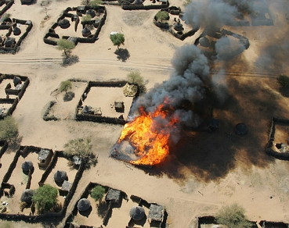
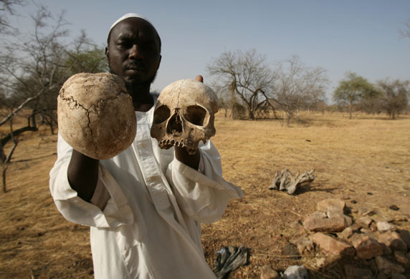
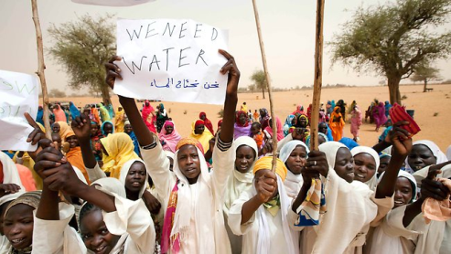
Factor 3: African Union has resolved Africa’s Problems?
FAILURE
It is difficult to assess its effectiveness as it is so new
The AU has tried to bring an end to conflict in Darfur from 2005+ (on-going) with limited success
It has a military force of around 7,000 in the area the size of Scotland & with so few troops it is impossible to act as peace-keeping force
It has also struggled to boost the African economy in any great way as there are still major trade barriers between countries resulting in poor internal trade

Slide 9
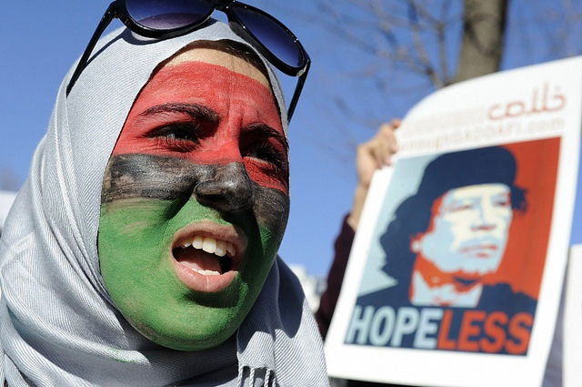
Factor 3: African Union has resolved Africa’s Problems?
FAILURE
However its weakness was made all too evident during the Libyan civil war
The AU attempted to mediate in the early stages in 2011 forming a committee with the aim of a truce however…
The beginnings of the NATO-led military intervention stopped the committee from traveling to Libya to meet with Gaddafi (the former head of the AU)
And… the UN’s ‘Resolution 1973’ that saw the fall of the Gaddafi regime was created & conducted without AU consultation!
This shows the AU’s failure to be seen as an established, respectable or significant organisation

Slide 10
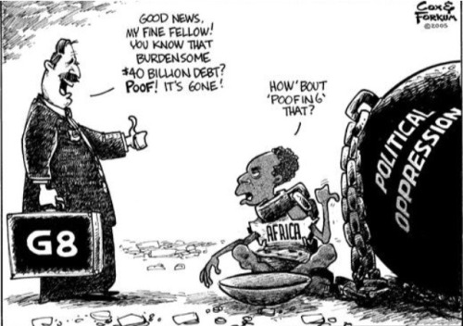
Factor 3: African Union has resolved Africa’s Problems?
JUDGEMENT:
Overall, the work and aims of the AU illustrates EXACTLY that aid alone is not enough to resolve Africa’s problems.
Their focus is to target Africa’s real problems: CORRUPTION; WAR & a NON-SUSTAINABLE ECONOMY
If these issues are resolved then African governments will begin to:
Raise appropriate taxes;
Be able to spend these taxes wisely to benefit the people;
Stop countries like Mozambique will stop being aid dependent on international aid
Thus in the long term the AU has the potential to become the most significant international organisation in helping Africa to develop

Slide 11
Factor 3: African Union has resolved Africa’s Problems?
Questions:
What is the focus of this organisation?
Why is this focus important?
Give an example of success
Give an example of failure
Explain why the AU has the potential to become the most significant organisation in Africa’s development

Slide 12
Factor 3: African Union has resolved Africa’s Problems?
TASK: Use The Plan To Write A Paragraph
Evaluate The Success Of International Organisations In Resolving A World Issue You Have Studied. 12 Marks
Start with : “Another international organisation that has seen success in resolving the troubles in Africa is the African Union.”
The AU’s focus is to… for example by targeting… (Knowledge)
This is extremely important in Africa because… (Explain)
One example of success is… (Example)
One example of failure is… (Example)
Therefore the African Union illustrates exactly that the problems within Africa cannot be fully resolved by aid because… (Judgement & Example)

Slide 13
Factor 3: African Union has resolved Africa’s Problems?
JUDGEMENT… Why Is Aid Not Effective?
War Disruption (refugees)
Extremist Groups (kidnapped girls)
Corrupt Governments misspending money
Large amounts of debts to be paid off which cant be directed into infrastructure
Poor Health (farmers)
Poor education
Evaluate The Success Of International Organisations In Resolving A World Issue You Have Studied. 12 Marks
Notes:
It is not the main factor affecting developemnt

