Slide 1
WORLD ISSUES: Development in Africa
ESSAY 1:
Factor X affects African development more than any other. Discuss.

Slide 2
Factors Affecting African Development:
Food And Water Shortages
SOCIAL
Health
Education
POLITICAL
Poor Governance
War & Conflict
ECONOMIC
DEBT
Trade Terms & Cash Crops

Slide 3
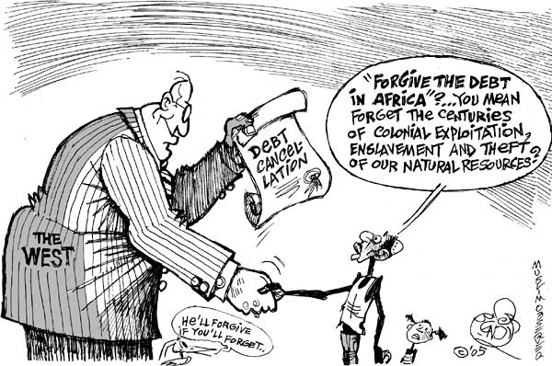
Factor 6: Debt Hinders Africa Development
Loans
Debt Cancellation
How Could Debt Hinder African Development?

Slide 4
Factor 6: Debt Hinders Africa Development
Why is Africa in Debt?
Upon independence from colonisation in the 1950s & 1960s many nations took large loans to help self-governance & development (and for a military to stay in power…)
Some of these debts are also known as ‘odious debt’ - taken out by corrupt governments and have been embezzled so citizens have seen no benefit to the debt they are paying off!
Africa has $300 billion of debt burden which is a huge obstacle to development – WHY?
African countries spend $14 billion annually repaying debt which is not spent on vital resources such as health and education.

Slide 5
Factor 6: Debt Hinders Africa Development
Where Did The Loans Come From?
Many African countries have borrowed money from the International Monetary Fund (IMF) or World Bank
BUT…
interest rates have fluctuated (and are high)
Strict conditions attached to repayment – 20-40% to pay back of the countries revenue each year
Market prices for goods sold abroad fluctuated
Dependency on a limited range of cash crops
Angola - rich in natural resources - Africa’s second largest oil producer & wealth in diamonds
History of civil war thus borrowed money to finance its military between 1975 & 2002
Spends 6.8% of countries GDP on loan repayments & 1.5% on health – more than 4x!!

Slide 6
Factor 6: Debt Hinders Africa Development
Debt Cancellation
2005 the richest 8 countries in the world (G8) agreed to cancel the debts owed to them by many African countries & real improvement has began:
Malawi has been able to train 4000 new teachers per year
Cameroon plans to build 1000 new health facilities and more than 2000 new schools
When Zambia’s $4 billion debt was cancelled the government introduced free health care for people in rural areas which scrapped unattainable fees for millions
The progress these countries have made since the debts have been cancelled really shows how debt has limited development over the decades when progress could have begun a long time ago
However the 2005 debt cancelation saw only 60% of debts cancelled many countries are still indebted to the IMF; World Bank or other developed countries

Slide 7
Factor 6: Debt Hinders Africa Development
Why Is There Such Debt In Africa…?
Conflict; (political)
Corruption Governments… (political)
Partly our fault...
For this question you would compare several factors in importance
Evaluate The Extent To Which A World Issue You Have Studied (The Lack Of Development In Africa) Has Been Caused By Social Problems (Poor Health) 12 MARKS
Notes:
It is not the main factor affecting developemnt

Slide 8
Factor 6: Debt Hinders Africa Development
Questions:
Why is Africa in so much debt? Three reasons…
How much debt is she in?
Where do countries get loans from to try & better their country? What problem do these loans create?
Examples of problems – Angola
What changed in 2005?
How have things got better?
Why is Africa still in debt?

Slide 9
Marking Grid – there are so many different ways to gain your marks
‘With Reference To A World Issue You Have Studied Analyse The Factors Which Have Caused The Issue.’ 12 Marks
KU = 8 marks
Analysis/evaluation = 4
 | 1 Mark | 2 Marks | 3 Marks | 4 Marks
Knowledge | 1 relevant description | 2 relevant descriptions OR 1 detailed relevant description | 1 relevant description AND 1 detailed relevant description | 2+ detailed relevant description
Explanation or Example | 1 basic explanation from KU from above OR example | 2 basic explanation from KU from above OR 1 detailed explanation | 1 detailed explanation AND 1 basic explanation | 2+ fully explained AND Examples
Analysis/ Evaluation Identify relationships/ make judgements | 1 analytical OR Evaluative comment | 1 analytical/Evaluative comment which is justified OR 2 basic analytical/ evaluative comment | 1 analytical/ Evaluative comment which is justified AND Examples | 1 extended analytical/ Evaluative comment which is justified
Notes:
Way 1: basic

Slide 10
Factor 6: Debt Hinders Africa Development
TASK: Use The Plan To Write A Paragraph
‘With Reference To A World Issue You Have Studied Analyse The Factors Which Have Caused The Issue.’ 12 Marks
Start with : “Another factor that contributes to the lack of development in Africa is debt.”
Why is Africa in so much debt (Knowledge)
What impact does this have today (Explain)
How much debt is Africa in? (Example)
What happened in 2005? (Knowledge)
What impact will this have? With an example (Explain & Example)
However… (Knowledge)
Link this to main argument (pretty much repeat 2.)

