Slide 1
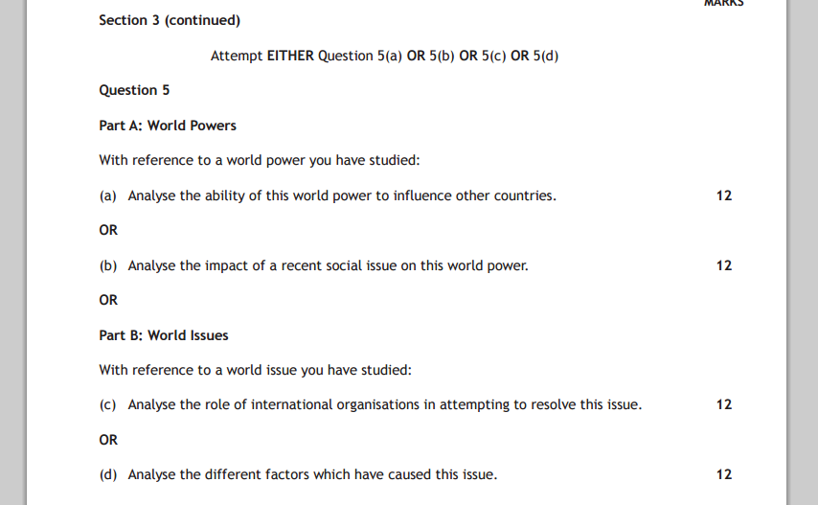
2015 QUESTIONS

Slide 2
Marking Grid: 20 Mark
 | 1 Mark | 2 Marks | 3 Marks | 4 Marks | 5-6 Marks
Knowledge | 1 relevant description | 2 relevant descriptions OR 1 detailed relevant description | 1 relevant description AND 1 detailed relevant description | 2+ detailed relevant description
Explanation or Example | 1 basic explanation of the KU from above OR Example | 2 basic explanation from KU from above OR 1 detailed explanation with examples | 1 detailed explanation AND 1 basic explanation | 2+ fully explained AND Examples | = max. 8 marks for KU ; examples & explanation
Analysis | 1 basic analytical comment | 1 Analytical comment which is justified or exampled OR 2 basic analytical comment | 1 Analytical comment which is justified AND Examples | 1 extended Analytical comment which is justified AND Examples | 2+ Analytical comment which is justified AND Examples
Structure | Different paragraphs that address the question | Paragraphs that show a clear & consistent line of argument |  |  | = Make sure each judgement at the end of paragraph links to your main argument
Judgements /Reach conclusions | Basic conclusion | A balanced conclusion | 2 balanced conclusions OR 1 extended, balanced & justified conclusion | 1 extended, balanced & justified conclusion AND Considers a range of viewpoints | = End of essay sum up - Sum up the social; economic & political factors & reach conclusion that is backed up

Slide 3
Introduction
Tell Marker What You Chosen Topic Is (One Sentence Which Is Edited To Address The Question)
Background (1 Sentence)
Line Of Argument (1 Sentence)
Factors (1 Sentence)
‘An International Issue Can Be Caused By A Range Of Political, Social And Economic Factors.’ Discuss With Reference To A World Issue You Have Studied. 20 marks
One world issue that is caused by a range of political social and economic factors is the lack of development in Africa.

Slide 4
Introduction
Tell marker what you chosen topic is (one sentence which is edited to address the question)
Background (1 sentence)
Line of argument (1 sentence)
Factors (1 sentence)
‘An International Issue Can Be Caused By A Range Of Political, Social And Economic Factors.’ Discuss With Reference To A World Issue You Have Studied. 20 marks
Africa is the second largest continent, with the second largest population comprised of 54 countries each of which have their own history, culture and developmental issues.

Slide 5
Introduction
Tell marker what you chosen topic is (one sentence which is edited to address the question)
Background (1 sentence)
Line of argument (1 sentence)
Factors (1 sentence)
‘An International Issue Can Be Caused By A Range Of Political, Social And Economic Factors.’ Discuss With Reference To A World Issue You Have Studied. 20 marks
Arguably the lack of development in many African countries has been caused by poor and corrupt governance dating back to many countries independence in the 1950’s & 60’s.

Slide 6
Introduction
Tell marker what you chosen topic is (one sentence which is edited to address the question)
Background (1 sentence)
Line of argument (1 sentence)
Factors (1 sentence)
‘An International Issue Can Be Caused By A Range Of Political, Social And Economic Factors.’ Discuss With Reference To A World Issue You Have Studied. 20 marks
However social factors such as poor education & economic factors such as debt also have had a major impact on development.

Slide 7
‘An International Issue Can Be Caused By A Range Of Political, Social And Economic Factors.’ Discuss With Reference To A World Issue You Have Studied. 20 marks
One world issue that is caused by a range of political social and economic factors is the lack of development in Africa. Africa is comprised of 54 countries each of which have their own history, culture and developmental issues. Arguably the lack of development in many African countries has been caused by poor and corrupt governance. However social factors such as poor education & economic factors such as debt also have had a major impact on development. = zero marks
To what extent has a world issue you have studied had an impact in different countries? 20 Marks
One world issue that impacts different countries is the lack of development in many counties in Africa. Africa is comprised of 54 countries each of which have their own history, culture and developmental issues. Arguably the impact of the lack of development has had a devastating effect on African Countries. Problems in health care; education and debt can all be linked to historic problems with poor or corrupt governments. = zero marks

Slide 8
Marking Grid
 | 1 Mark | 2 Marks | 3 Marks | 4 Marks | 5-6 Marks
Knowledge | 1 relevant description | 2 relevant descriptions OR 1 detailed relevant description | 1 relevant description AND 1 detailed relevant description | 2+ detailed relevant description
Explanation or Example | 1 basic explanation of the KU from above OR Example | 2 basic explanation from KU from above OR 1 detailed explanation with examples | 1 detailed explanation AND 1 basic explanation | 2+ fully explained AND Examples | = max. 8 marks for KU ; examples & explanation
Analysis | 1 basic analytical comment | 1 Analytical comment which is justified or exampled OR 2 basic analytical comment | 1 Analytical comment which is justified AND Examples | 1 extended Analytical comment which is justified AND Examples | 2+ Analytical comment which is justified AND Examples
Structure | Different paragraphs that address the question | Paragraphs that show a clear & consistent line of argument |  |  | = Make sure each judgement at the end of paragraph links to your main argument
Judgements /reach conclusions | Basic conclusion | A balanced conclusion | 1 extended, balanced & justified conclusion | 1 extended, balanced & justified conclusion AND Considers a range of viewpoints | = End of essay sum up - Sum up the factors & reach conclusion that is backed up

Slide 9
Conclusion
Tell marker what you line of argument is & explain it with examples
Show the marker balance and explain with examples
Justify your main argument – why is it the most important, link it to other factors
‘An International Issue Can Be Caused By A Range Of Political, Social And Economic Factors.’ Discuss With Reference To A World Issue You Have Studied. 20 marks
In conclusion, the lack of development in Africa has been caused by a range of social, economic and political factors. However arguably political factors such as poor or corrupt governments are the most important factor because they decide how the countries budget is spent e.g. on arms or health care.

Slide 10
Conclusion
Tell marker what you line of argument is & explain it
Show the marker balance and explain with examples
Justify your main argument – why is it the most important, link it to other factors
‘An International Issue Can Be Caused By A Range Of Political, Social And Economic Factors.’ Discuss With Reference To A World Issue You Have Studied. 20 marks
However it is not only political factors that has caused a lack of development in Africa. Social factors have also impacted development because an unhealthy & uneducated population lack the skills needed to develop a countries infrastructure. Also economic factors such as debt has made it very difficult to have enough resource to develop these basic amenities.

Slide 11
Conclusion
Tell marker what you line of argument is & explain it
Show the marker balance and explain with examples
Justify your main argument – why is it the most important, link it to other factors
‘An International Issue Can Be Caused By A Range Of Political, Social And Economic Factors.’ Discuss With Reference To A World Issue You Have Studied. 20 marks
Therefore it can be argued that if African countries were able to introduce a system of democratic reform then development should increase as funds would be directed to help the nation rather than be diverted into corrupt leaders bank accounts

