Slide 1
WORLD ISSUES: Development in Africa
ESSAY 2:
The Success Of International Organisations In Resolving Problems in Africa

Slide 2
Role & Effectiveness Of International Organisations In Attempts To Resolve The Issue
SUCCESSFUL
European Union (EU)
Non-Government Organisation (NGO)
Bilateral Aid From UK
African Union
(AU)
UNSUCCESSFUL
United Nations (UN)

Slide 3
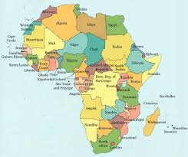
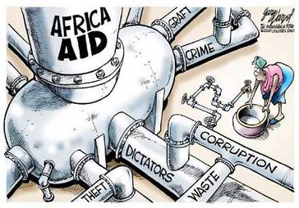
Introduction To African Aid
Africa is the second largest continent, with the second largest population comprised of 54 countries each of which have their own history, culture and developmental issues…
This essay focuses on the foreign aid given to Africa and how effective they are in resolving problems
Each paragraph focuses on the successes & failures of specific organisations which give aid to Africa
HOWEVER your last paragraph (before the conclusion) should argue that Corrupt Government’s; War or Unfair Trade Terms hinder African development MORE than the advancements achieved by aid

Slide 4
THREE TYPES OF AID
BILATERAL = single country e.g. Britain to another country to Africa. Often this is tied Aid, with conditions attached.
MULTILATERAL = agencies made up of funding from several countries e.g. UN, EU or African Union that use the money gathered from each country to reduce poverty
NGO’s = non-government organisations that receive their funding from public donations e.g. charities – Oxfam
Describe The Differences Between Multilateral; Bi-lateral & NGO Aid

Slide 5
Aims Of The Essay:
Understanding Of The 3 Types Of Foreign Aid That Is Given To Africa (Bilateral; Multinational Or Non-Government Organisations)
Understand The Successes and Failures Of Each Of These Groups
Understand That Aid Alone Is Not Enough To Develop Africa

Slide 6
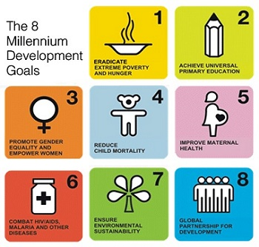
Factor 1: United Nations has resolved Africa’s Problems?
Millennium Development Goals
UNICEF
FAO

Slide 7
Factor 1: United Nations has resolved Africa’s Problems?
Background to the United Nations:
The UN is a multilateral agency set up in 1945 after WWII
One of the main aims is for countries to co-operate in order to promote economic and social progress throughout the world Specialised Agencies work to aid and assist countries in need & nowhere is it needed more than in many countries in Africa.The UN operates a series of specialised agencies (e.g. UNICEF; UNESCO; FAO; WHO) each agency has a particular focus when it comes to meeting the needs of developing countries
Multilateral aid benefits from large funding which means large effective projects can be undertaken
However, the UN has been criticised for not meeting all of the 2015 Millennium Development Goals

Slide 8
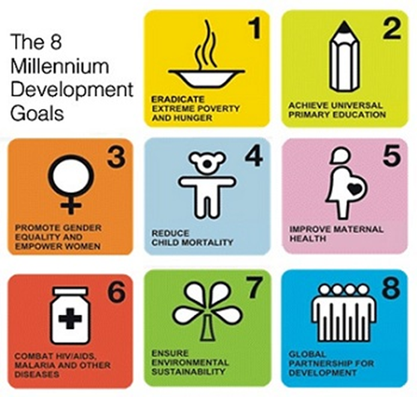
Factor 1: United Nations has resolved Africa’s Problems
Millennium Development Goals
In Sept 2000 at the UN Millennium Summit, nearly 190 countries signed up to 8 precise targets designed to eradicate world poverty and hunger and achieve universal primary education for all by 2015

Slide 9
Factor 1: United Nations has resolved Africa’s Problems?
UNICEF
Focuses on the needs and improving the lives of children and their mothers through emergency aid, medical programmes, EDUCATION PROGRAMMES and promoting children’s rights
Education is viewed as an important method to improve development of African nations because it is the best way to lift families out of poverty; improve their futures and educate about HIV & aids
E.G. The continued 2014 ‘Schools for Africa’ campaign worked with governments, local authorities and communities in 11 African countries including Mali; Rwanda & Mozambique to help some of the millions of the children in Africa who do not go to school
Since its launch more than 12 million children have benefited from increased access to education and better quality education, with the building of 415 new classrooms in Mali & Burkina Faso & training 10,000 teachers in Ethiopia, Mali, Malawi & Niger
UNICEF also provided educational materials like pencils and schoolbags, hygiene supplies such as sanitary cloths and soap, plus sports equipment such as footballs

Slide 10
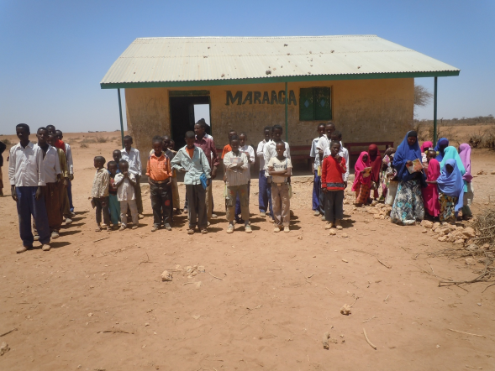
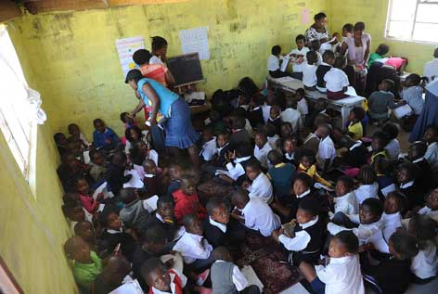
Factor 1: United Nations has resolved Africa’s Problems?
UNICEF
Despite the success in these countries there are still major problems:
In Africa enrolment levels are the lowest in the world – 33 million children not attending school
Areas like Somalia enrolment in schools is still very low at only 23%!
There are still high dropout rates – 72% in Chad
And for those with access to schools many do not have properly trained teachers - Malawi less than 60% of teachers have undergone teacher training
With overcrowded classrooms (40-70 kids!) & a lack of teaching resources

Slide 11
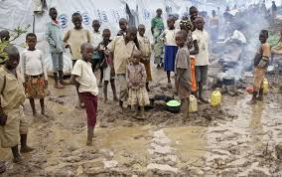
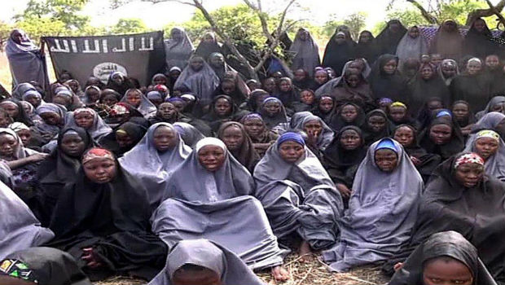
Factor 1: United Nations has resolved Africa’s Problems?
UNICEF – Judgement...
Therefore UNICEF has had a fair amount of success in educations HOWEVER there are still clear problems within education that can not be solved by aid alone…
WAR & CONFLICT: The War in Darfur (Sudan) a country has created 2 million refugees who fled their homes – this has led to 20% higher adult illiteracy as education is disrupted
EXTREMIST GROUPS: In 2014 300 school girls were kidnapped due to the conflict between Christians & Muslims over disputes about women in education – since then 10 million young Nigerians are no longer in school for their own safety - this will have a major long term effect on the countries development

Slide 12
Factor 1: United Nations has resolved Africa’s Problems?
Questions UNICEF:
What is the focus of UNICEF?
Why is education important?
Give an example of success
Give an example of failure
Explain why aid alone cannot solve the problems in education.

Slide 13
Factor 1: United Nations has resolved Africa’s Problems?
TASK: Use The Plan To Write A Paragraph
Evaluate The Success Of International Organisations In Resolving A World Issue You Have Studied. 12 Marks
Start with : “One international organisation that has seen success in resolving the troubles in Africa is the United nations.”
Within the UN one specialised group is UNICEF. The focus of this organisations is to… (Knowledge)
This is extremely important in Africa because… (Explain)
One example of success is… (Example)
One example of failure is… (Example)
Therefore UNICEF has seen success because...(more kids in school) however due to…(war/conflict & extremist groups) the problems within education has not been resolved for example… (Judgement & Example)

Slide 14
Factor 1: United Nations has resolved Africa’s Problems?
FOOD & AGRICULTURE ORGANISATION
The FAO aims promote development in Africa through tacking hunger
They do this by raising awareness amongst rural communities as to how best to manage land and water supplies and increase food production
Hunger is a massive problem in Africa and malnutrition results in productivity and economic losses as adults are unable to work - time is lost as many have to walk for miles to collect water ach day
SUCCESS:
Somalia is currently facing its worse famine in 20 years - the FAO has provided nearly 160,000 farmers with fertilisers & seeds
They have also improved the country’s infrastructure by repairing roads & canals which helps to ensure food gets to sellers as quickly as possible

Slide 15
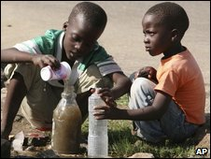
Factor 1: United Nations has resolved Africa’s Problems?
FOOD & AGRICULTURE ORGANISATION
FAILURES:
The FAO estimated that 239 million people (around 30% of the population) in sub-Saharan Africa were hungry in 2010
Over the whole continent only about half of the population has access to clean water
For many in rural areas rivers and lakes are the only source of water - these are affected seasonally
Access to water is better in urban areas (towns & cities) however there is little sanitation so sewage pollutes water supplies – Zimbabwe 2008 saw a major cholera outbreak

Slide 16
Factor 1: United Nations has resolved Africa’s Problems?
FOOD & AGRICULTURE ORGANISATION
JUDGEMENT:
Therefore FOA has had a fair amount of success in tacking the problems of hunger however there are still clear problems which aid alone from the FAO cannot resolve …
POOR HEALTH: By 2020, it is estimated that HIV/Aids will kill 20% of southern Africa’s farm workers – this will have considerable long term effects on the food available
WAR & CONFLICT: Emergency aid can also be disrupted by fighting, attacks and hijacking of aid trucks so much so that food becomes a weapon; this so called ‘scorched earth policy’ where soldiers will destroy land, crops and livestock, wells are contaminated forcing people off their land
This results in a loss in food production, a country will produce around 12.4% less food per person when in conflict e.g. Angola’s food production was down 44%!

Slide 17
Factor 1: United Nations has resolved Africa’s Problems?
Questions FAO:
What is the focus of FAO?
Why is food & water supplies important?
Give an example of success
Give an example of failure
Explain why aid alone cannot solve the problems in food shortages.

Slide 18
Factor 1: United Nations has resolved Africa’s Problems?
TASK: Use The Plan To Write A Paragraph
Evaluate The Success Of International Organisations In Resolving A World Issue You Have Studied. 12 Marks
Start with : “Another international organisation that has seen success in resolving the troubles in Africa is FAO.
The focus of this organisations is to… (Knowledge)
This is extremely important in Africa because… (Explain)
One example of success is… (Example)
One example of failure is… (Example)
Therefore FAO has seen success however due to… the problems within food and water shortages has not been resolved for example… (Judgement & Example)

Slide 19
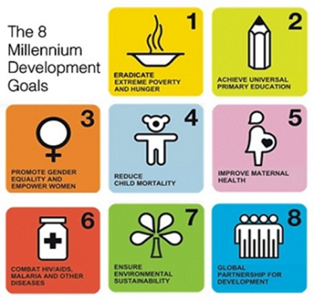
Factor 1: United Nations has resolved Africa’s Problems?
Millennium Development Goals
In Sept 2000 at the UN Millennium Summit, nearly 190 countries signed up to 8 precise targets with a range of goals designed to improve life for people in developing countries
The MDGs are arguably the most successful global anti-poverty push in history – combining governments, international organizations and civil society groups around the world
Successfully they have cut in half the world’s extreme poverty rate; increased the number of girls in school & reduced child mortality rates (not specific enough for essay)
Critics however suggest that while nations such as India and China have achieved most of the goals, many African countries, particularly those in the Sub-Saharan region, have missed the mark by a wide margin because the goals were simply unrealistic

Slide 28
Factor 1: United Nations has resolved Africa’s Problems?
Millennium Development Goals
SUCCESSES:
Africa has halted and reversed the spread of HIV/ AIDS, with a drop in prevalence rates from 5.9 per cent in 2001 to 4.9 per cent in 2011
Halving the number in extreme poverty from 47% to 22%
FAILURES:
However the performance of African countries on reducing hunger varies markedly:
3 countries reduced hunger by 50 per cent or more (Ghana, the Democratic Republic of the Congo and Mauritania)
19 reduced hunger 20.0–49.9 per cent
13 reduced hunger 0.0–19.9 per cent
Five countries (Burundi, Swaziland, Comoros, Cote d’Ivoire and Botswana) experienced setbacks…

Slide 29
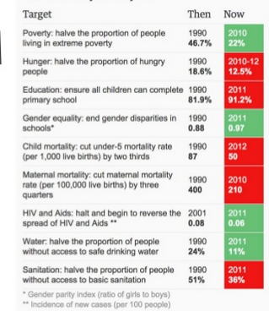
Factor 1: United Nations has resolved Africa’s Problems?
Millennium Development Goals
By 2011 the continent reduced its under-five mortality rate 47% however an inexcusable amount of children and pregnant women still die every year from preventable causes
Burkina Faso has a primary school enrolment of approximately 45% & setting impossible goals takes attention away from any legitimate progress that was made and unfairly creates a false impression of failure, which may jeopardize international funding for future development initiatives

Slide 30
Factor 1: United Nations has resolved Africa’s Problems?
Millennium Development Goals
Few countries made progress towards achieving the goals, especially since the recession hit in 2008 when many countries have reduced their donations – however not the UK
These failures have led to the goal post being shifted to 2030 and the MDG’s now known as the ‘Sustainable Development Goals’
JUDGEMENT:
Africa has come a long way since 2000, making substantial progress toward several of the MDGs - Malawi, Rwanda & Ethiopia are making especially impressive progress
It is thus imperative that countries continue learning from each others political stability and human development–oriented policies

Slide 31
Factor 1: United Nations has resolved Africa’s Problems?
Questions FAO:
What were the aims of the MDG’s? (Knowledge)
Give an example of success (Example)
What 2 reasons have been blamed for failing to reach the goals? (Explain)
Give an example of failure (Example)
What are the MDG knowns as now? & what do countries need to do to ensure theses aims are met?

Slide 32
Factor 1: United Nations has resolved Africa’s Problems?
TASK: Use The Plan To Write A Paragraph
Evaluate The Success Of International Organisations In Resolving A World Issue You Have Studied. 12 Marks
Start with : “The UN has also been criticised for failing resolving the troubles in Africa.”
Background to the MDG & aims (Knowledge)
Describe some successes & explain how this will help Africa (Example & Explain)
Explain why the goals have not been met (Explain)
One example of failure is… & explain how this will continue to hinder Africa (Example & Explain)
Therefore the UN has been partly successful however due to… the problems within Africa has not been resolved for example… (Judgement & Example)

Slide 33
Factor 1: United Nations has resolved Africa’s Problems?
JUDGEMENT… Why Is Aid Not Effective?
War Disruption (Refugees)
Extremist Groups (Kidnapped Girls)
Corrupt Governments Misspending Money
Large Amounts Of Debts To Be Paid Off Which Cant Be Directed Into Infrastructure
Poor Health (Farmers)
Poor Education
Evaluate The Success Of International Organisations In Resolving A World Issue You Have Studied. 12 Marks
Notes:
It is not the main factor affecting developemnt

