Slide 1
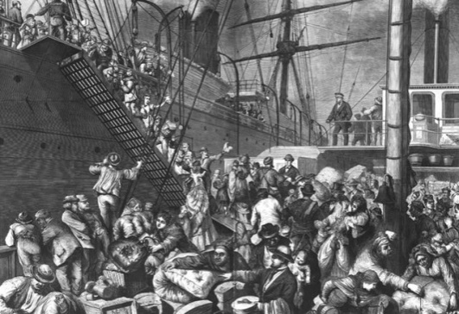
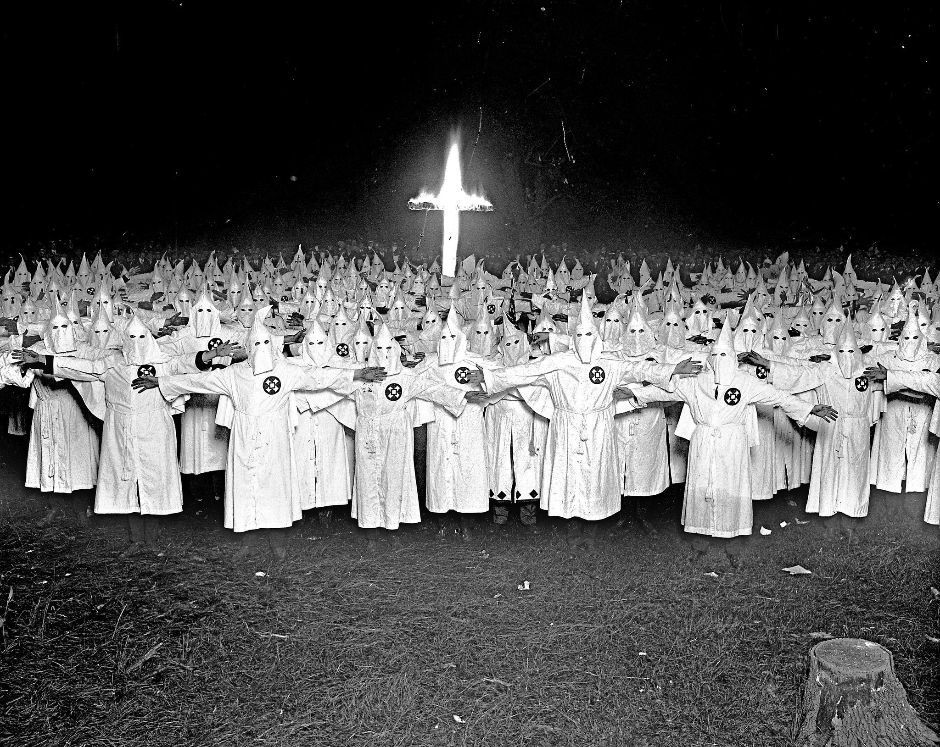
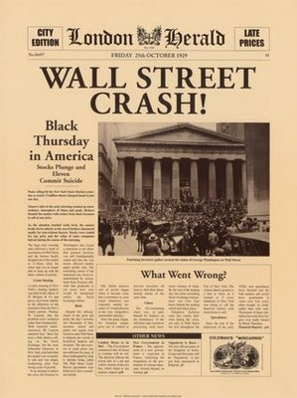
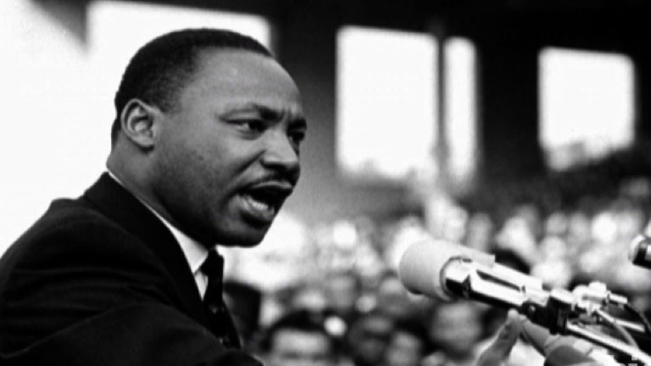
3. USA, 1918-1968
5 essays to learn BUT only 1 to write in the exam

Slide 2
Issue 3
An Evaluation Of The Reasons For The Economic Crisis 1929-33:
Factor 1: Republican Governments Policies
Factor 2: Overproduction & Under-consumption
Factor 3: Weaknesses Of The Banking System
Factor 4: International Economic Problems
Factor 5: Wall Street Crash
AIMS OF ESSAY:
To Be Able To Discuss the factors which contributed to the economic (financial) crisis in American between 1929 & 1933

Slide 3
Aims Paragraph 4:
To Understand How Banks Were Regulated
To Explain How Republican Policies Impacted The Banking Crisis
Have The Background Knowledge & Argument To Write Your Third Paragraph For Essay 3

Slide 4
PLAN FOR PARAGRAPH Weaknesses Of The Banking System
1. Start with an Opening Argument e.g. state there is a link between the isolated factor & the question
2. Put in Knowledge – detail the problems within the banking system
3. Put in Analysis – explain what this led to & why (un…)
4. Knowledge – details of what the system created & the ‘run’ on the banks
5. Analysis – explain why this happened & the impact this had
6. Evaluation – make an evaluation, how important was this factor?
Read Through Paragraph 3 On Handout

Slide 5
Little Regulation
The unsound banking system that existed in America was caused by the under regulation of the banks by the federal reserve board (who's fault…?)
In 1921 there were 30,000 independent banks - set up in response to the demand for hire purchase credit to buy all the new mass-produced goods
For example 3/4‘s of cars on the road were bought on credit & by 1927 $7 billion of goods were sold on credit!
The banks happily loaned out huge amounts of their investors' cash, expecting to make big profits on interests to the loans as well as in the stock market themselves
However… as these banks were very small they were unable to withstand major setbacks - say due to a crop failure (and between 1921-28 5,000 went bust for similar reasons)
If they collapsed their investors would lose virtually all their savings

Slide 6
Crisis In Confidence
The banks were loaning large amounts of their investor’s money and were expecting to make large profits which did not happen – especially following the Wall Street Crash when loans could not be repaid
As a result there was a crisis in confidence in the banks and people began to withdraw their savings as they were afraid of losing their money
Many banks lacked resources to fulfil these obligations and as a result large numbers of banks collapsed
A ‘run on the bank’ occurred which was when panic-stricken people demanded their money back from the bank
As above the banks could not pay back the money and as a result went bankrupt and collapsed
In 1929, 659 banks closed losing a total of $200 million and in 1931, 2,294 banks closed losing a total of $1.7 billion

Slide 7
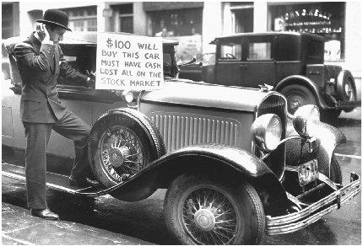

Slide 8
SUM UP: Weaknesses Of The Banking System
Major problem was lack of regulation
Banking system was made up of thousands of small banks
They gave out loans too easily to unreliable clients
When one bank collapsed it often led to a ‘run’ on other banks, resulting in a banking collapse as the bank itself could not pay back investors
Without doubt the weak banking system was caused by the Republicans laissez-faire approach to politics
And failed to impose adequate banking regulations
The banking system was unstable with many small banks and financial institutions unable to cope with severe losses
Notes:
Evaluation

Slide 9
Background Questions
Q1. The unsound banking system in America was caused by what?
Q2. How many independent banks were there in 1921?
Q3. Why were these banks set up?
Q4. Give an example of the extent to which credit existed in America?
Q5. Which 2 ways did banks make money?
Q6. However what problems did small banks face?
Q7. What happened to investors capital if the banks collapsed?
Q8. Why was there a crisis in confidence?
Q9. What happened during the crisis of confidence?
Q10. What does the term ‘run on the banks’ mean?
Q11. What happened between 1929 & 1931?
Q12. Sum up 4 key problems with the banks that led to the problems?
Notes:
Evaluation

Slide 10
OPENING ARGUMENT Weaknesses Of The Banking System
Another factor which contributed to the economic crisis of the 1930s was the weaknesses of the US banking system

Slide 11
Weaknesses Of The Banking System
KNOWLEDGE 1
1920s only 1/3 of banks were under regulation of the Federal Reserve Board
= no one was checking on how much money banks were lending or investing
ARGUMENT 1
It can be argued that this caused the economic crisis because…
…banks would engage in risky lending practices
such as investing in stocks & shares and giving loans to people who could never pay it back
Because they were NOT PROPERLY REGULATED

Slide 12
Weaknesses Of The Banking System
KNOWLEDGE 2
System created thousands of small banks
Problematic when one bank went bust it led to a ‘run’ on the other banks
where people lost confidence in their secure saving & tried to withdraw their saving
ARGUMENT 2
It can be argued…
banks had lent so much money to share speculators that when faced with loans being called in they couldn’t make the payments
Therefore the wall street crash resulted in the banks going bust and unable to repay their investors

Slide 13
Weaknesses Of The Banking System
EVALUATION:
Overall the banks were central to the crisis in the 1930s. Their foolish practices created an unhealthy economy which was vulnerable to a crash. However the weaknesses must ultimately lie with the Republican policies which created the ‘laissez-faire’ climate in which the banks operated

