Slide 1
WORLD ISSUES: Development in Africa
ESSAY 1:
Factor X affects African development more than any other. Discuss.

Slide 2
Factors Affecting African Development:
Food And Water Shortages
SOCIAL
Health
Education
POLITICAL
Poor Governance
WAR & Conflict
ECONOMIC
DEBT
Trade Terms & Cash Crops

Slide 3
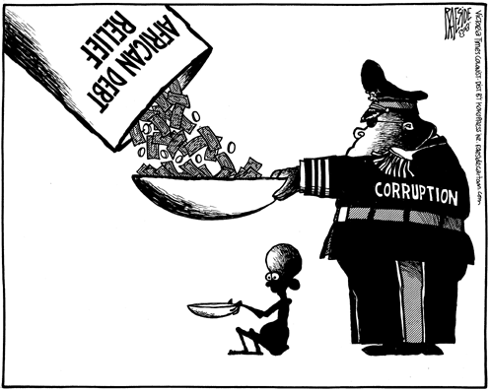
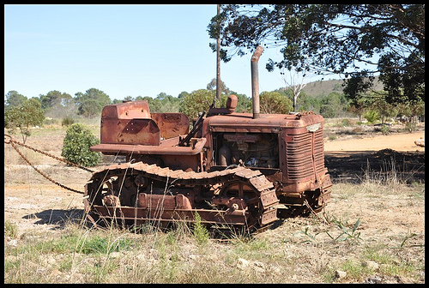
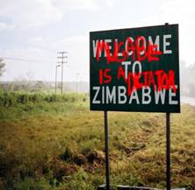
Factor 4: Poor Governance
Hinders Africa Development
Good Governance is an essential component of a developed country – WHY?
Political Corruption
Poor Governance
Case Study - Zimbabwe

Slide 4
Nearly a trillion dollars has been spent on aid in Africa since the 1960s but the situation for Africans is worse than ever
Aid projects (when finally reaching the people who need it) can be poorly coordinated and money spent on items that are inappropriate & without consultation with locals who are now left abandoned with useless projects
E.G. tractors without money for diesel or ability to get replacement parts!
Bad governance however can be a lot worse than simply buying the wrong equipment...
Factor 4: Poor Governance Hinders Africa Development
Poor Governance

Slide 5
Factor 4: Poor Governance Hinders Africa Development
Following the fall of colonialism there has been a real struggle for power within many African countries and conflict has erupted in attempts to overthrow the government
In the worst cases dictators dramatically hinder development – doing anything to hold on to power including using violence against their opposition
Funds are diverted to equip the military who will ensure that the government remains in power
It can mean that the government cannot be trusted to deliver key services or hold fair elections
Not only this but the police also cannot be trusted, human rights are abused and the legal system is not independent!
Political Corruption

Slide 6
Factor 4: Poor Governance Hinders Africa Development
‘Odious debt’ are loans given to countries with corrupt governments which have been misspent or embezzled – the impact is more debt to be paid off & no benefits for citizens
Kleptocracy describes a dictator who exercises power to the benefit themselves at the expense of the population at large
Essential services (e.g. schools, hospitals) are denied the money they need because funds are used to maintain the corrupt political system
The African Union in 2002 estimated that corruption cost Africa $148 billion a year & 50% of tax revenues are ‘lost’
For example, Nigeria is a country rich in crude oil & national resources yet the vast majority of the population live on $2 a day! Politicians here also make double what MPs make in the UK…
Kleptocracy

Slide 7
Factor 4: Poor Governance Hinders Africa Development
President Mugabe has been in power since 1980
He has received £307 million in aid however it believed that money has been diverted to other projects
Out of the population of 12 million, over 4 million have emigrated abroad - many of whom are the skilled and educated people Zimbabwe needs!
There are many reasons why these people have left the country:
in 2009 the unemployment rate stood at 85%
Life expectancy fell from 54yrs for men in 1994 to 37yrs in 2008
70% of the population below the poverty line
Case Study - Zimbabwe

Slide 8
Factor 4: Poor Governance Hinders Africa Development
The rate of inflation stood at around 1,200% (a loaf of bread that cost z$500 in Aug 2009, cost z$10,000 in September)
There is no freedom of speech or right to assembly therefore they cannot rise against conditions
Rate of HIV infection is one of the highest in the world with 25% of the population being infected.
There is an extreme shortage of medicines and medical equipment which caused major problems during a cholera outbreak in 2008
For these reasons foreign investment and tourism have collapsed
Case Study - Zimbabwe

Slide 9
Factor 4: Poor Governance Hinders Africa Development
CONSEQUENCES OF ON AFRICA:
Aid projects are poorly coordinated - money spent on items that are inappropriate & without consultation with locals who are now left abandoned with useless projects E.G. tractors without money for replacement parts!
The African Union in 2002 estimated that corruption cost Africa $148 billion a year & 50% of tax revenues are ‘lost’
Aid money is diverted to other projects – impacts education & health care e.g. equip the military who will ensure that they remain in power
‘Odious debt’ has created more debt to be paid off & no benefits for citizens
Many emigrate abroad - many of whom are the skilled and educated the people these countries need!
Reduces tourism & foreign investment due to fear of corrupt police forces & crime rates caused by poverty
SEE ZIMBABWE – life expectancy; medical availability...etc

Slide 10
Factor 4: Poor Governance Hinders Africa Development
Why Is There Such Poor Governance In Africa…?
To A Large Extent It Is Our Fault...
COLONIALISM
Evaluate The Extent To Which A World Issue You Have Studied (The Lack Of Development In Africa) Has Been Caused By Social Problems (Poor Health) 12 MARKS
Notes:
It is not the main factor affecting developemnt

Slide 11
Factor 4: Poor Governance Hinders Africa Development
Questions:
How does inappropriate use of aid hinder Africa?
Why can the British Empire be partly blamed for the situation in Africa?
What is Kleptocracy?
How do corrupted governments hinder Africa through diverted funds?
What examples can you use from Zimbabwe to support the argument that poor governance hinders development?

Slide 12
Marking Grid – there are so many different ways to gain your marks
‘With Reference To A World Power You Have Studied Analyse The Factors Which Have Caused The Issue.’ 12 Marks
KU = 8 marks
Analysis/evaluation = 4
 | 1 Mark | 2 Marks | 3 Marks | 4 Marks
Knowledge | 1 relevant description | 2 relevant descriptions OR 1 detailed relevant description | 1 relevant description AND 1 detailed relevant description | 2+ detailed relevant description
Explanation or Example | 1 basic explanation from KU from above OR example | 2 basic explanation from KU from above OR 1 detailed explanation | 1 detailed explanation AND 1 basic explanation | 2+ fully explained AND Examples
Analysis/ Evaluation Identify relationships/ make judgements | 1 analytical OR Evaluative comment | 1 analytical/Evaluative comment which is justified OR 2 basic analytical/ evaluative comment | 1 analytical/ Evaluative comment which is justified AND Examples | 1 extended analytical/ Evaluative comment which is justified
Notes:
Way 1: basic

Slide 13
Marking Grid – there are so many different ways to gain your marks
‘With Reference To A World Power You Have Studied Analyse The Factors Which Have Caused The Issue.’ 12 Marks
KU = 8 marks
Analysis/evaluation = 4
 | 1 Mark | 2 Marks | 3 Marks | 4 Marks
Knowledge | 1 relevant description | 2 relevant descriptions OR 1 detailed relevant description | 1 relevant description AND 1 detailed relevant description | 2+ detailed relevant description
Explanation or Example | 1 basic explanation from KU from above OR example | 2 basic explanation from KU from above OR 1 detailed explanation | 1 detailed explanation AND 1 basic explanation | 2+ fully explained AND Examples
Analysis/ Evaluation Identify relationships/make judgements | 1 analytical OR Evaluative comment | 1 analytical/Evaluative comment which is justified OR 2 basic analytical/ evaluative comment | 1 analytical/ Evaluative comment which is justified AND Examples | 1 extended analytical/ Evaluative comment which is justified
Notes:
Way 2: quicker but more difficult - 2/3 fully explain descriptions and explanations of how this factor caused the issue, with examples = 8 marks PLUS 2x justified with examples

Slide 14
Factor 4: Poor Governance Hinders Africa Development
TASK: Use The Plan To Write A Paragraph
‘With Reference To A World Issue You Have Studied Analyse The Factors Which Have Caused The Issue.’ 12 Marks
Start with : “One factor that contributes to the lack of development in Africa is poor governance.”
Use your KU to construct a KNOWLEDGE/EXAMPLE/ANALYSIS answer
Explain why development is not happening through looking at the poor governance with examples
Explain why this is not happening through looking at corrupt governments with examples
Finish with an obvious analytical comments that ‘Identify relationships’
Sum up how poor governance is linked to EVERY OTHER factor we have looked at so far & have a knock on effect I hindering African development

Slide 15
Factor 4: Poor Governance Hinders Africa Development
ANSWERS
‘With Reference To A World Issue You Have Studied Analyse The Factors Which Have Caused The Issue.’ 12 Marks
One factor that contributes to the lack of development in Africa is poor governance (Knowledge). It can be argued that poor governance can be linked to each key factors affecting development as the resources that are so desperately needed are being diverted elsewhere or used inappropriately. (Analysis)
For example, nearly a trillion dollars has been spent on aid in Africa since the 1960s but the situation for Africans is worse than ever (Example). Aid projects can be poorly coordinated and money spent on items that are inappropriate such as tractors without money for diesel or ability to get replacement parts (Detailed Explanation)
Following the end of colonialism there has been a real struggle for power within many African countries resulting in conflict in attempts to overthrow the government (Knowledge). In the worst cases dictators dramatically hinder development – doing anything to hold on to power including using violence against their opposition & diverting funds that could be spent on education & health to equip the military who will ensure that the government remains in power. (Detailed Explanation) The African Union in 2002 estimated that corruption cost Africa $148 billion a year & 50% of tax revenues are ‘lost’. (Example)

