Slide 1
WORLD ISSUES: Development in Africa
ESSAY 1:
Factor X affects African development more than any other. Discuss.

Slide 2
Factors Affecting African Development:
Food And Water Shortages
SOCIAL
Health
Education
POLITICAL
Poor Governance
WAR & Conflict
ECONOMIC
DEBT
Trade Terms & Cash Crops

Slide 3
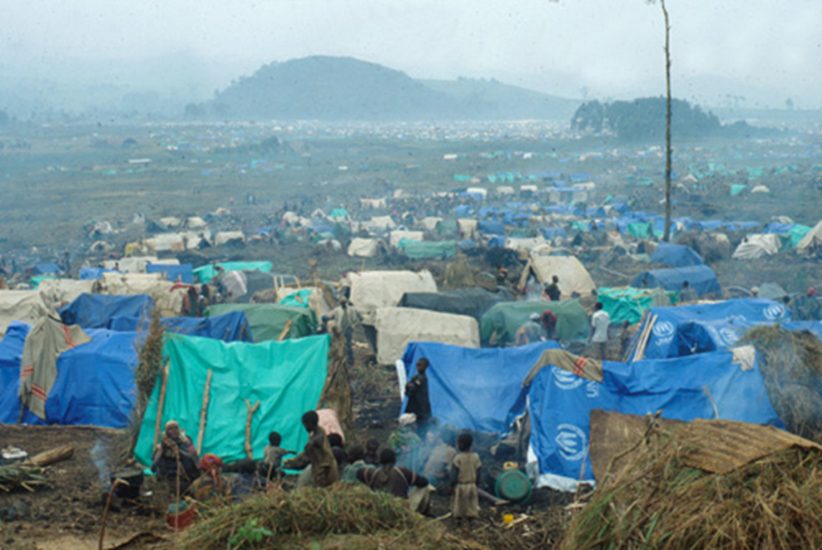
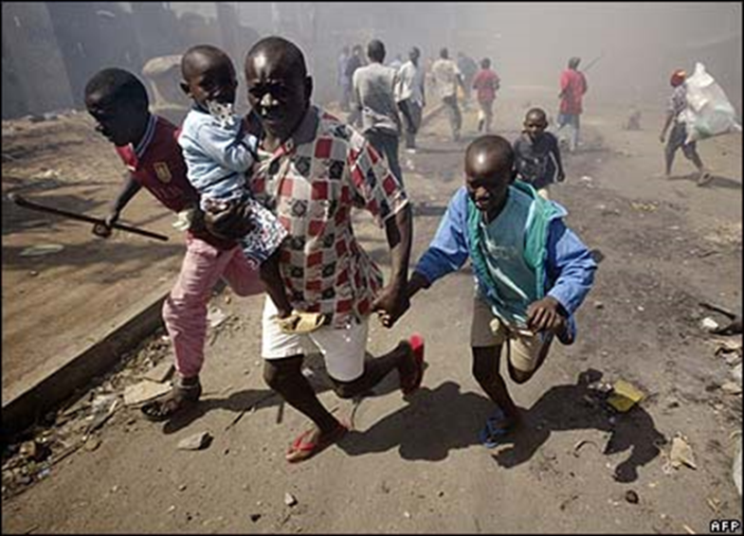
Factor 5: War & Conflict Hinders Africa Development
Refugees
Cost
How Does Conflict/ War Affect Africa?

Slide 4
Factor 5: War & Conflict Hinders Africa Development
The Problem in Africa
Africa is a very diverse continent, with a long history of conflict between different religious groups AND between dictators and civilizations within a country
Africa is more affected by armed conflict than any other continent with 15 African countries being involved in war/experiencing post-war conflict and tension in 2011
In last 20 years, the majority of deaths in world from internal or external conflict were in Africa (War that occurs within a country is known as a civil war)
Conflict can tear a country apart & have devastating effects on development in a variety of different ways

Slide 5
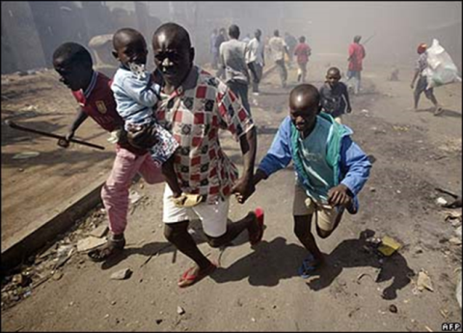
Factor 5: War & Conflict Hinders Africa Development
What Are The Costs Of Conflict On Africa?
From immediate food shortages to the need for long term reconstruction of infrastructure such as roads
A recent Oxfam report demonstrated that the cost of the continent’s development over a 15 year period was nearly $300 billion!
Costing yearly civil war costs on average Africa $18 billion
The money spent on weapons & soldiers could have been spent elsewhere on vital services like health care & development programs
50% more infant death
15% more undernourished people
Life expectancy reduced by 5 years
20% more adult illiteracy
2.5 times fewer doctors per patient
12.4% less food per person
African Countries Involved In Conflict Have, On Average:

Slide 6
Factor 5: War & Conflict Hinders Africa Development
What Are The Costs Of Conflict On Africa?
Worse than this however is the use of children as soldiers in areas like Chad; Somalia & Sudan
This has long term psychological effects on the population as well as them not receiving any education to help rebuild their country
Emergency aid can also be disrupted by fighting, attacks and hijacking of aid trucks
Food becomes a weapon; this so called ‘scorched earth policy’ where soldiers will destroy land, crops and livestock, wells are also contaminated forcing people off their land
This results in a loss in food production e.g. Angola’s food production was down 44%!

Slide 7
Factor 5: War & Conflict Hinders Africa Development
Refugees
There have been over 9 million refugees and internally displaced people in Africa since 2000
These people are uprooted from homes and land and cannot be self-sufficient in terms of food, nor have regular access to medical care or aid, as well as hindering the next generation with a lack of consistent education
Therefore a lack of basic amenities means that millions struggled to survive LET ALONE help to develop their country
In 2014 Southern Sudan (independent of Sudan since 2011) various tribes are in conflict for power & land, saw 1.5 million displaced from their homes; 3.7 million people needing immediate humanitarian aid & 7 million suffering from lack of food security

Slide 8
Factor 5: War & Conflict Hinders Africa Development
CONSEQUENCES OF ON AFRICA:
Children often become orphans or dragged into conflict to fight
Millions uprooted from their homes – this destroys any prospect of being self sufficient
Vast number of refugees are left without water; shelter or medical support
Emergency aid is disrupted/stopped because of the dangers caused by fighting/high-jacking of aid trucks
Food becomes a weapon with soldiers destroying food & livestock - scorched earth policy & wells contaminated
Food production is seriously affected – areas affected losing more than 12 % of production – Angola 44%!
Disrupts exports & tourism
However most importantly is the loss of life & misspent money

Slide 9
Factor 5: War & Conflict Hinders Africa Development
Why Is There War & Conflict In Africa…?
Corruption Governments… (political)
Possibly our fault...?
Evaluate The Extent To Which A World Issue You Have Studied (The Lack Of Development In Africa) Has Been Caused By Social Problems (Poor Health) 12 MARKS
Notes:
It is not the main factor affecting developemnt

Slide 10
Factor 5: War & Conflict Hinders Africa Development
Questions:
Give some background – how bad a problem is conflict for Africa as a whole?
How much money is spent on conflict & what else could this be spent on?
How is quality of life reduced due to conflict? Examples
What is life like for refugees?
What is life like in South Sudan?

Slide 11
Factor 2: Cash Crops & Trade Hinders Africa Development
TASK: Use The Plan To Write A Paragraph
‘With Reference To A World Issue You Have Studied Analyse The Factors Which Have Caused The Issue.’ 12 Marks
Opening sentence which introduces the factor e.g. Conflict
Give an example of how bad the problem in Africa is (Knowledge)
Explain, with an example, that it wastes money that could be spent elsewhere & detail evidence of reduced life quality that shows the impact (Explain – ‘this hinders African development because…’ & Examples)
Details on refugees (Knowledge)
Explain how this had long term affects (Explain)
Example of Southern Sudan (Examples)
Link Conflict to another factor e.g. lack of food & water – ‘scorched water policy’ & Corrupt governments (Evaluation)

Slide 12
Marking Grid – there are so many different ways to gain your marks
‘With Reference To A World Issue You Have Studied Analyse The Factors Which Have Caused The Issue.’ 12 Marks
KU = 8 marks
Analysis/evaluation = 4
 | 1 Mark | 2 Marks | 3 Marks | 4 Marks
Knowledge | 1 relevant description | 2 relevant descriptions OR 1 detailed relevant description | 1 relevant description AND 1 detailed relevant description | 2+ detailed relevant description
Explanation or Example | 1 basic explanation from KU from above OR example | 2 basic explanation from KU from above OR 1 detailed explanation | 1 detailed explanation AND 1 basic explanation | 2+ fully explained AND Examples
Analysis/ Evaluation Identify relationships/ make judgements | 1 analytical OR Evaluative comment | 1 analytical/Evaluative comment which is justified OR 2 basic analytical/ evaluative comment | 1 analytical/ Evaluative comment which is justified AND Examples | 1 extended analytical/ Evaluative comment which is justified
Notes:
Way 1: basic

