Slide 1
Barbara Moir
Careers Adviser
Dalkeith High School
S1 Future Me

Slide 2
Notes:
Introduce SDS and My World of Work
Discuss SDS and the careers service offer in-school and post-school
Discuss MyWoW and what key information can be found there to help with career related queries, research and help give ideas around what industries might suit each individual

Slide 3
Future Me
Notes:
Advise that they will each receive a copy of this Welcome to S1 magazine.
Future Me – Welcome to S1 is a welcome magazine for pupils starting high school which gently introduces them to SDS and My World of Work. It explains what a Careers Adviser is and the help and support young people can expect to receive from them. The magazine has fun content around personality types and future jobs with interactive quizzes to keep the readers engaged. (magazine updated annually)

Slide 4
These are the skills you need to make your career a success.
Your SDS Careers Adviser is just one of the people who can help you develop these skills.
Some of them you’ll have already – just by being you!
Notes:
SELF is about
understanding who I am and what I can do
knowing what is right for me
reviewing my life, work and learning plan.
STRENGTHS is about
understanding all about my skills, knowledge and experience
knowing more about what I can do
reviewing which of my skills are transferrable.
HORIZONS is about
understanding the world of work
understanding what options might be available to me
knowing which options I should choose
knowing what I need to do to make my choice
reviewing my links between life, learning and work
reviewing where I fit into the world of work.
NETWORKS is about
understanding who can help me
knowing how to make connections with those who can help me
reviewing my networks.

Slide 5
Activity!
Notes:
Challenging stereotypes and unconscious bias that reduce openness to opportunity
Your future is your choice. What you have learned, in school and out of it, already influence how you think about careers. Your choices and experiences from now on will help you explore what kind of future you want to shape…we want to help you be open to all opportunities.
Every time ANYONE makes a decision their background, personality, values and life experience influence that decision. This works well in most day-to-day decisions but when its an important decision we need to understand our Unconscious Bias.
Anyone heard of it or want to take a guess what it is? It is where…
Form a quick opinion about a person or situation without really being aware of why
Opinions based on past experiences or influence of other people/media not research and reflection
Bias can be positive or negative but we need to recognise how they influence us and when we need to overcome that bias
See Facilitators notes & Prompt Sheet for more on different Unconscious Bias such as: Beauty Bias; Conformity Bias and Gender Bias
Activity – next 5 slides have an image of a young persons face only (rest of picture revealed in stages)
initial impressions, take a guess at what type of jobs they might do (group should be thinking about unconscious bias so likely to pick roles not traditionally linked to that gender - this still proves the bias is there but that awareness means Bias can be challenged)
What if you had more information? Share 3 or 4 hints to what the job is (from slide notes) and reveal one to two panels over the image...
Final guess (shout out or write it down on paper).
After discussion reveal full screen
Optional Extra Challenge – Additional LMI questions and answers have been added to slide notes for each job to further challenge thinking and support quiz creation such as Kahoot.
Advisers can create localised examples... (if creating own slides please use images from SDS sources/screengrabs to avoid copyright infringement or your own images with suitable permissions to use for this purpose in line with GDPR)

Slide 6
What do they do?
Notes:
Engineer
deals with complex written and spoken instructions...
wears protective clothing...
3. has to diagnose and fix...
Extra Challenge Questions ****
In 2019, what percentage of construction worker were women? 15% of UK construction workforce were women so there is a huge drive to attract more women into this industry
What do you think was the average wage per hour for someone in Construction & Building trades? In the UK £10.50 (practical skilled jobs like roofer or joiner average between £24-29,000 jobs like Construction Manager £52,000)
Last year, what percentage of the construction workforce were self-employed? 27%

Slide 7
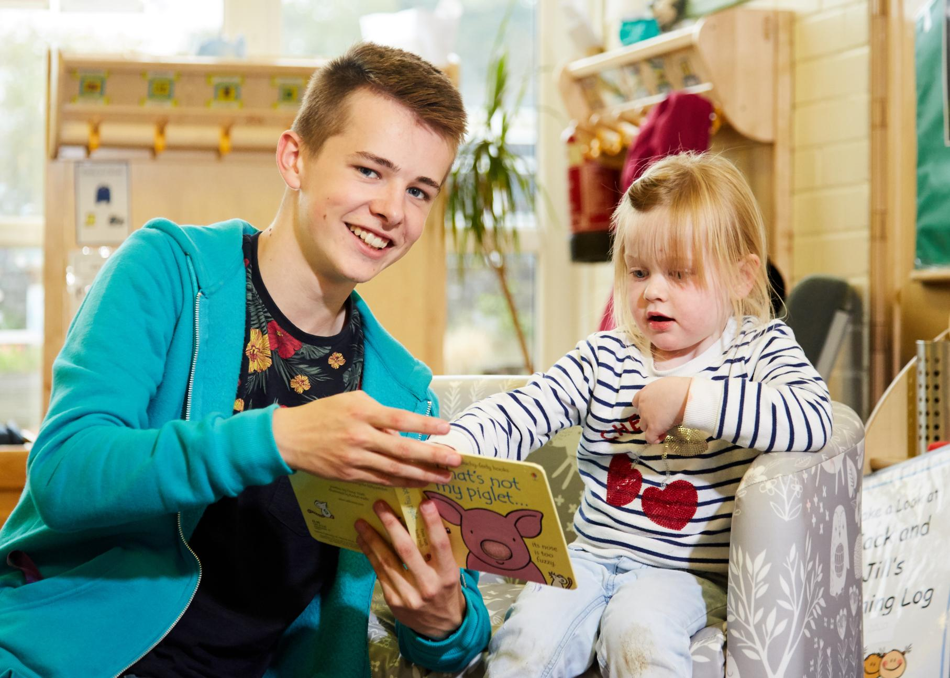
What do they do?
Notes:
Nursery Worker
could work with many demanding customers at once...
has great customer service and interpersonal skills...
works within legal guidelines...
Extra Challenge Questions
What percentage of Early Learning & Childcare worker were men in 2019? Only 4% of childcare workers were men, children need both male and female role models so lots of work to change this.
In 2019, what do you think was the average wage per hour for someone in childcare? In the UK £8.00 per hour (Early years nursery worker on average earns £17,500 per year, Nanny £20,000 and a Nursery manager £30,000)

Slide 8
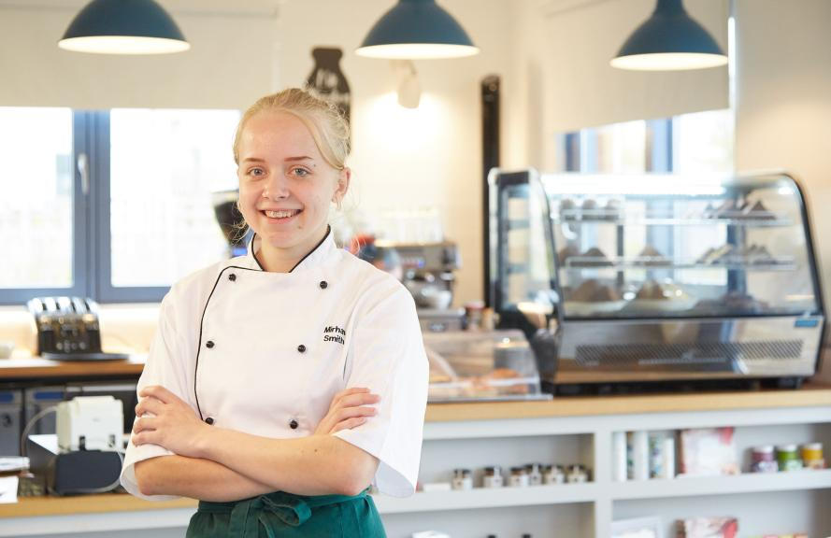
What do they do?
Notes:
Foundation Apprenticeship Chef
Gain work experience while still at school
Will be able to follow government health & hygiene standards
Gain an insight into how food production factories operate
Extra Challenge Questions *******
Ten people joined the first year of the Foundation Apprenticeship in Food & Drink in 2018 how many have signed up to do it in 2019?
Answer – 60 (FA Report page 12)
Did more male or more female pupils sign up for the Food & Drink Technician Foundation Apprenticeship in 2019?
Answer – slightly more males, 32 males and 28 females. Along with Business Skills and Scientific Technologies, this was one of the FA’s with the most equal gender balance. (FA Report page 12)
The Foundation Apprenticeship can lead onto a Modern Apprenticeship, but not everyone who starts an apprenticeship completes it – what percentage of Food & Drink Modern Apprentices completed their qualifications?
Answer - 81% Achievement rate, joint highest with 3 other groups (creative & cultural skills; manufacture; transport & logistics all 81%) (MA report, Table D3 page 55)
Name one famous drinks company which offered work-place experience as part of the Foundation Apprenticeship last year.
Answer - Coca-Cola, it was one of a wide range of employers offering real experience to FA pupils (FA Report page 27)
Out of the 7 Scottish universities that offer degree courses linked to Food & Drink Technologies how many accept the Foundation Apprenticeship?
Answer – 6 out of 7. Aberdeen and UHI both accept it as equivalent to 2 Higher and the other universities as 1 Higher. Only Edinburgh University does not accept it for entry to their food & drink linked course, but we are working on this.
How many bottles of whiskey does Scotland export every second?
Answer – 39 bottles are shipped overseas every second (Food & Drink Scotland)
Scotland’s food and Drink industry is worth about £14 Billion each year, but what percentage of this money comes from health food? (2019)
Answer – roughly 14% or £685million
What percentage of UK Grown food is consumed in the UK?
Answer - 60%, the EU is our largest trading partner. (Statista)

Slide 9
What do they do?
Notes:
Fashion Designer MA
Works in fast-paced and demanding environment...
Responds to customer enquiries...
Must always be well turned out and presentable...
Extra Challenge Questions *****
In 2019, what percentage of sales and retail Modern Apprentices are male? 42% of last years retail MA’s were male
What do you think was the average wage per hour? In the UK £7.50 (sales assistant around £20,000 jobs like sales manager £35,000)

Slide 10
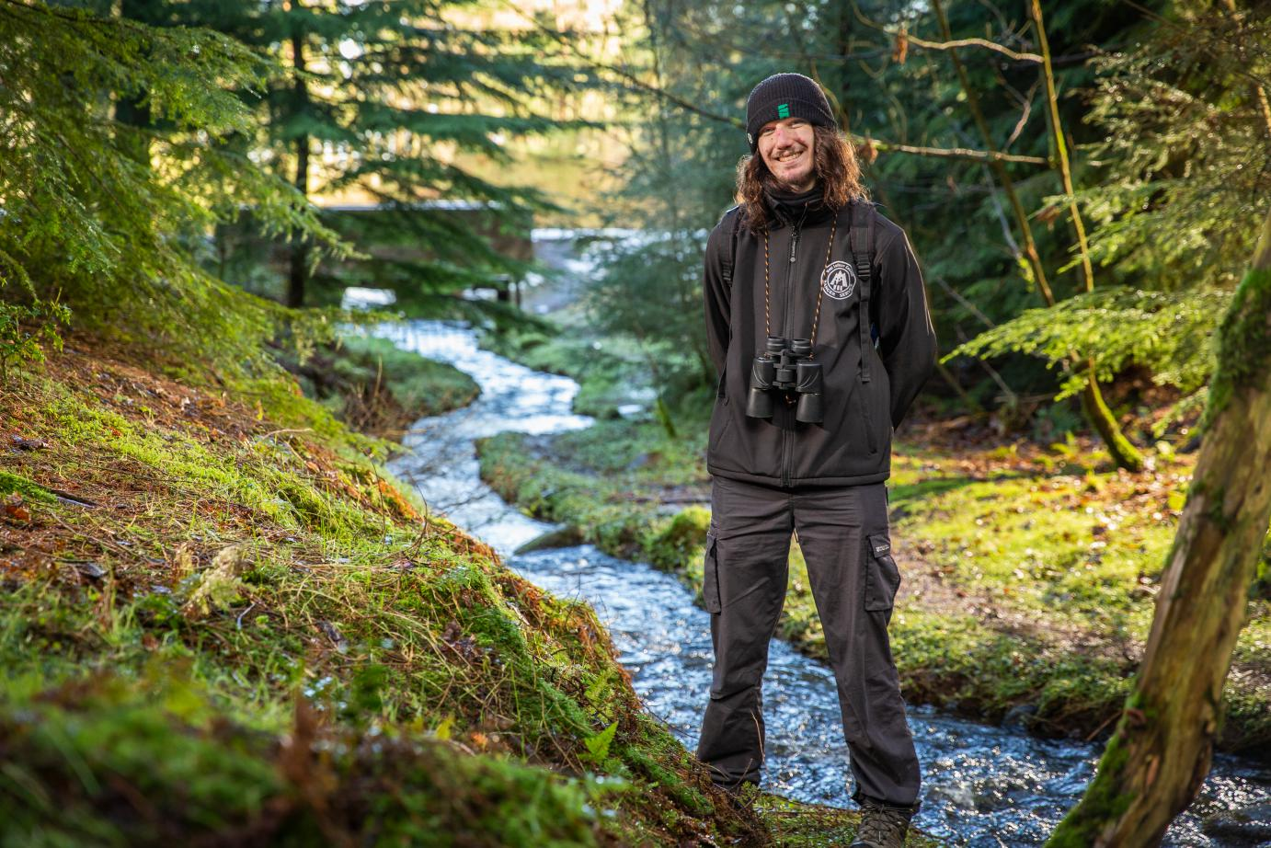
What do they do?
Notes:
Modern Apprentice as a Forestry Worker
Will need to be aware of health and safety working outdoors
Will need to be a good communicator with different team members
Have good practical skills
Extra Challenge Questions ******
The number of women entering Automotive Apprenticeships has more than doubled since 2016 – what percentage of new start Automotive MA’s in 2019 were female?
Answer – 5% or 58 people out of 1,159 – this is more than double the 27 female starting in 2016 but a long way from equal (MA report, page 21)
The average weekly wage in the UK is £505 per week or £13 per hour. Do you think most mechanic get paid more or less than this average?
Answer – They get a higher weekly wage £570 per week but average £13 per hour – why? because generally mechanics work more hours, so earn more. (LMI for All)
Roughly how many motor vehicle repair workshops are there in the UK?
Answer - 21,000 (Statista)
How many people were employed in the automotive sector across the UK in 2018?
Answer - 823 thousand people (Statista)
What percentage of cars in the UK were predicted to be hybrid or electric plug-in by 2020?
Answer – 10% and this is likely to grow – innovative vehicles creates a need for innovations in vehicle care and repair services (Statista)

Slide 11
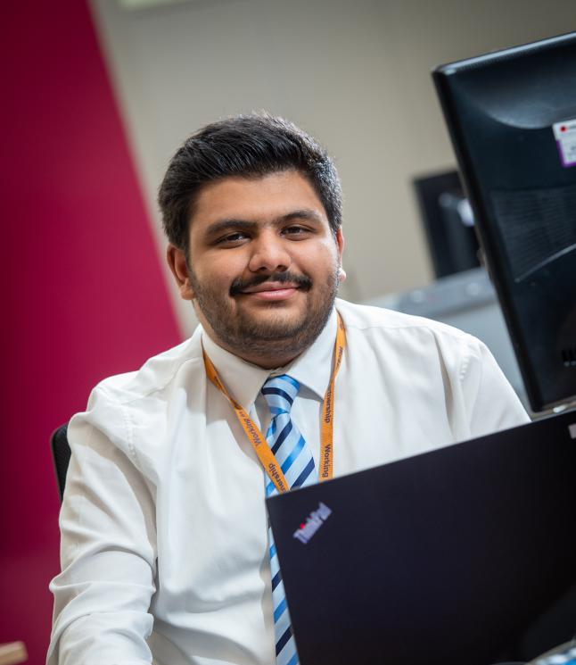
What do they do?
v
v
v
v
Notes:
Modern Apprentice in Creative & Digital Media
work with technical equipment
work with multimedia
works well in a team
Extra Challenge Questions
This job connects to both the creative and digital sectors - in 2019 which one was the bigger employer in Scotland? Digital Sector. Over 90,000 people work digital technology roles in Scotland and latest figures show 77,000 working in Creative Industries
The average salary in Scotland last year was £28,000 per year would a job in digital technology pay more or less? More. The average full-time salary for digital technology roles is £37,500 this is over 30% higher than the Scottish average of £28,000

Slide 12
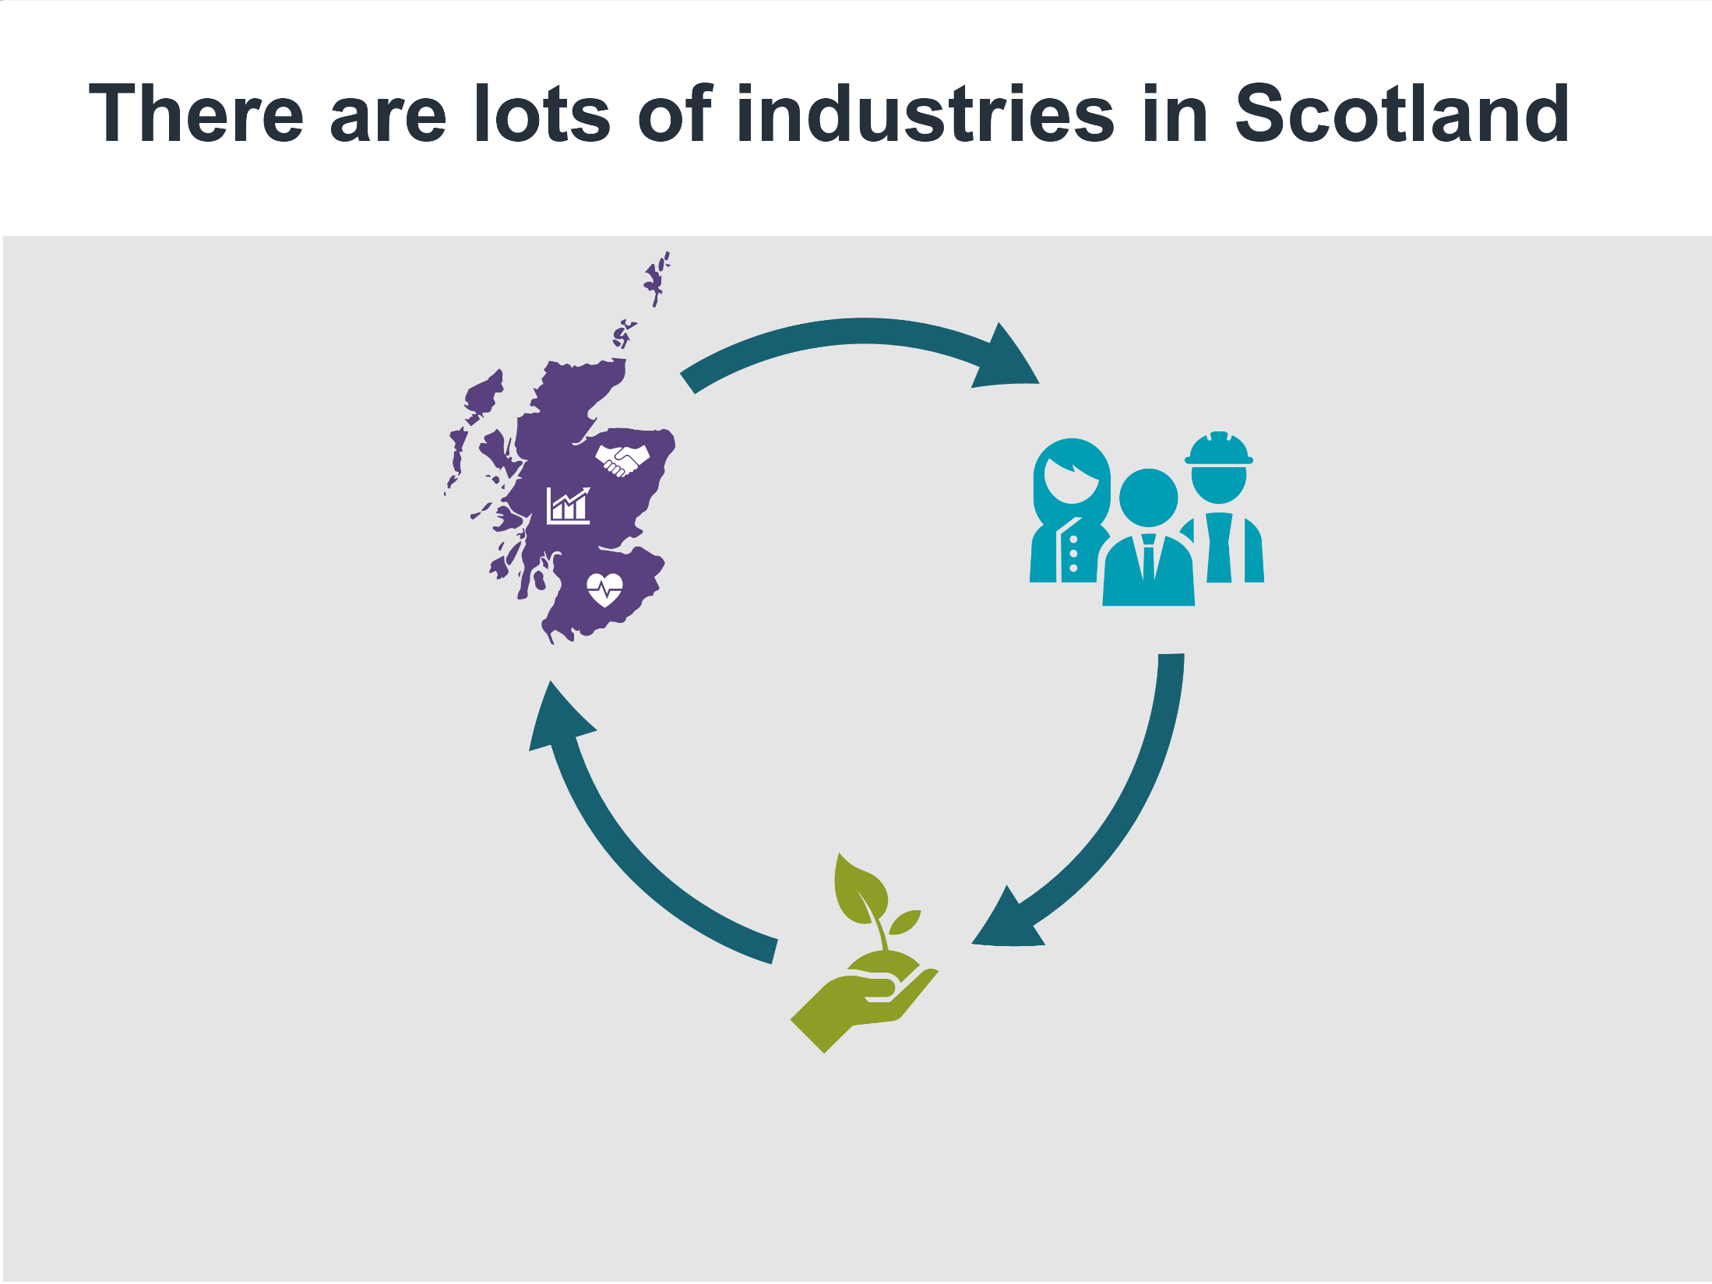
When
Industries
Grow
The
creates
jobs
But to grow they need people with the right
skills and fresh ideas
Notes:
To introduce the idea there are lots of industries which can grow and change but only if they have people with the right skills.
Note: Industries have always experienced change, times of growth, decline or stagnation, these industries do not disappear but shift and change to with the labour market. Industries need more people during times of growth but even in times of stagnation or decline industry still need staff.

Slide 13
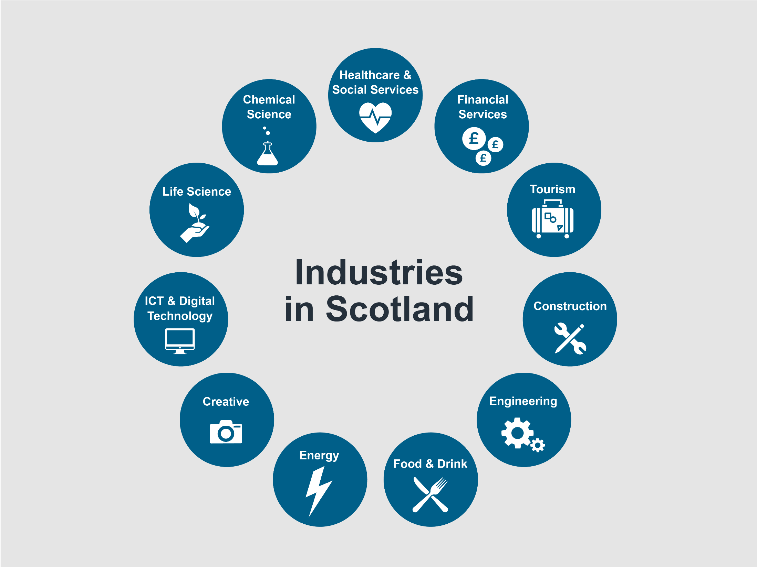
Notes:
Symbols/Industry titles link to related My WoW Industry page for LMI and ‘jobs in this Industry’
This activity is to raise awareness of the some of the key industries in Scotland and how we group jobs.
Industry sectors symbols appear first. Ask group to guess the type of industries/jobs the symbol might represent.
Click to reveal all industry sectors titles.
Ask the group to guess different jobs that belong to one (or more) sector.
Which three industries do you think were the biggest in Scotland in 2019? 1. Healthcare & Social Services, over 203,000 in Social Services and over 160,000 in NHS Scotland, countries biggest employer, 2. Construction, over 170,000 and upward of 60,000 self employed workers, 3. Tourism over 200,000 people and 14,000 businesses
You can use the LMI Toolkit on Connect to see the current LMI picture for different sectors.
P7-S1 ADDITIONAL ACTIVITY – expand learning with ‘How Many Careers…’ or ‘Life Raft / Shark Island’ games (see supporting slide)

Slide 14
Activity!
Notes:
Optional resources for this activity are;
Who’s job is it anyway?
Life Raft
Shark Island
Full activity, facilitator notes and worksheets are available on the Welcome to S1 Connect page.

Slide 19
So what’s next?
Depending on your school, you’ll be taking subject choices either in S2 or S3.
That may seems like ages away, but stuff you do now can really help with those decisions.
1
Get registered on myworldofwork and use the About Me tool.
2
Once you know a bit more about what you like and what you’re good at, you’ll be able to see what kinds of careers might suit you.
Also try the Subject Choices tool. It’s easy to use, and shows you what subjects would be useful for what career.
You’ll find the tool at myworldofwork/subjectchoices
3
4
You’ll also get time with your SDS Careers Adviser at subject choices time.
Notes:
Reminder of what they should be doing after this session...
Register on My World of Work – you will use this website all through school so get started now!
Use the About Me tool – will help you understand more about your likes, what you're good at and what types of jobs might suit you
Try out the Subject Choice tool – really easy to use and shows what subjects would be most useful for different jobs.

Slide 20
Time to get started!
Notes:
Encourage the group to visit and use our website My World of Work – myworldofwork.co.uk – get familiar with it as they will visit it site again and again as they progress through school and beyond.
SDS YouTube has a 2min video on Registering on My WoW if required - https://www.youtube.com/watch?edufilter=NULL&v=T9gO5icAB3E

Slide 21
Thank you.
Barbara Moir
Careers Adviser
Barbara.moir@sds.co.uk
Tues Interval – Dining Hall

