Slide 1
Labour Market Intelligence and Career Pathways

Slide 2
School Coordinator Role
Connecting employers with young people across Scotland
Helping them understand and develop the skills they need for the world of work.
This is done through skills sessions, career events, mock interviews and workplace visits

Slide 5
Growing Industries in Midlothian
Construction
Life Science
Animal Care
Social Care
Hospitality

Slide 6
Career Pathways

Slide 7
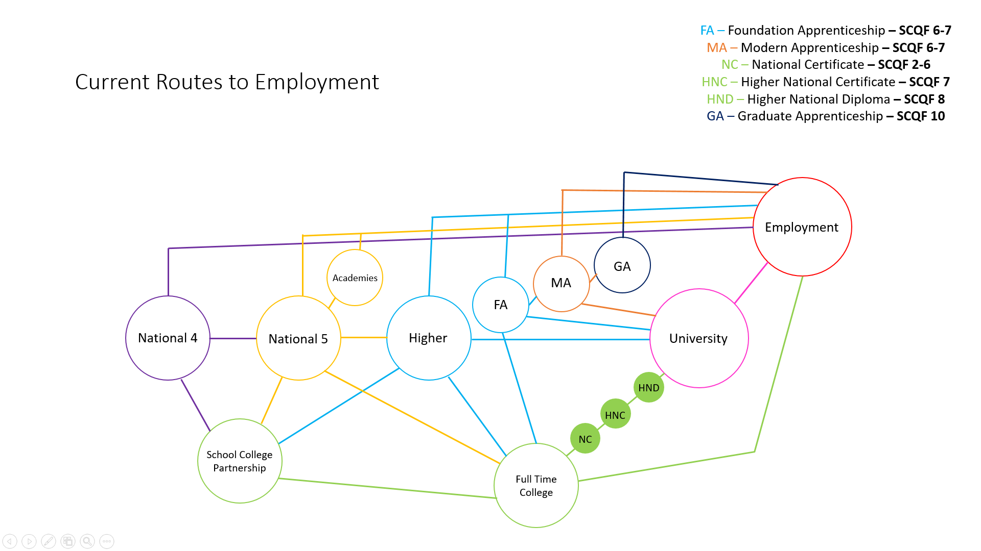
Current Routes into Employment

Slide 8
Apprenticeships
Experience an industry, get a qualification
Senior Phase work based learning
Progress to a job, college or university, Modern or Graduate Apprenticeship
Get a job, get paid, get qualified
Equivalent to:
L2 to National 5
L3 to Higher or Advanced Higher
L4 to HND or Ordinary degree
L5 to Honours Degree to Masters
Get a job, get paid, get a degree
GAs are work-based degree apprenticeship programmes which are offered at SCQF levels 8, 10 and 11.

Slide 9
College
Higher National Certificate (HNC)
Progress studies to a more specific knowledge of your subject area
Allow you to practice work based skills to prepare for joining the workforce
Equivalent to completing the first year of University
SCQF 7
Higher National Diploma (HND)
More in-depth study of chosen subject
Practical work to accompany the theory being taught
Equivalent to the first two years of University
SCQF 8
National Certificate (NC)
Great starting point for building knowledge in a specific area
Stepping stone into higher education
Provides core skills required to be workplace ready
SCQF 2-6

Slide 10
University
SCQF 9-10
Courses can be between 3 – 5 years
Ideal if choosing a specific career path
Broad range of courses to choose from
Can be reached through school, college, and/or apprenticeships

Slide 11
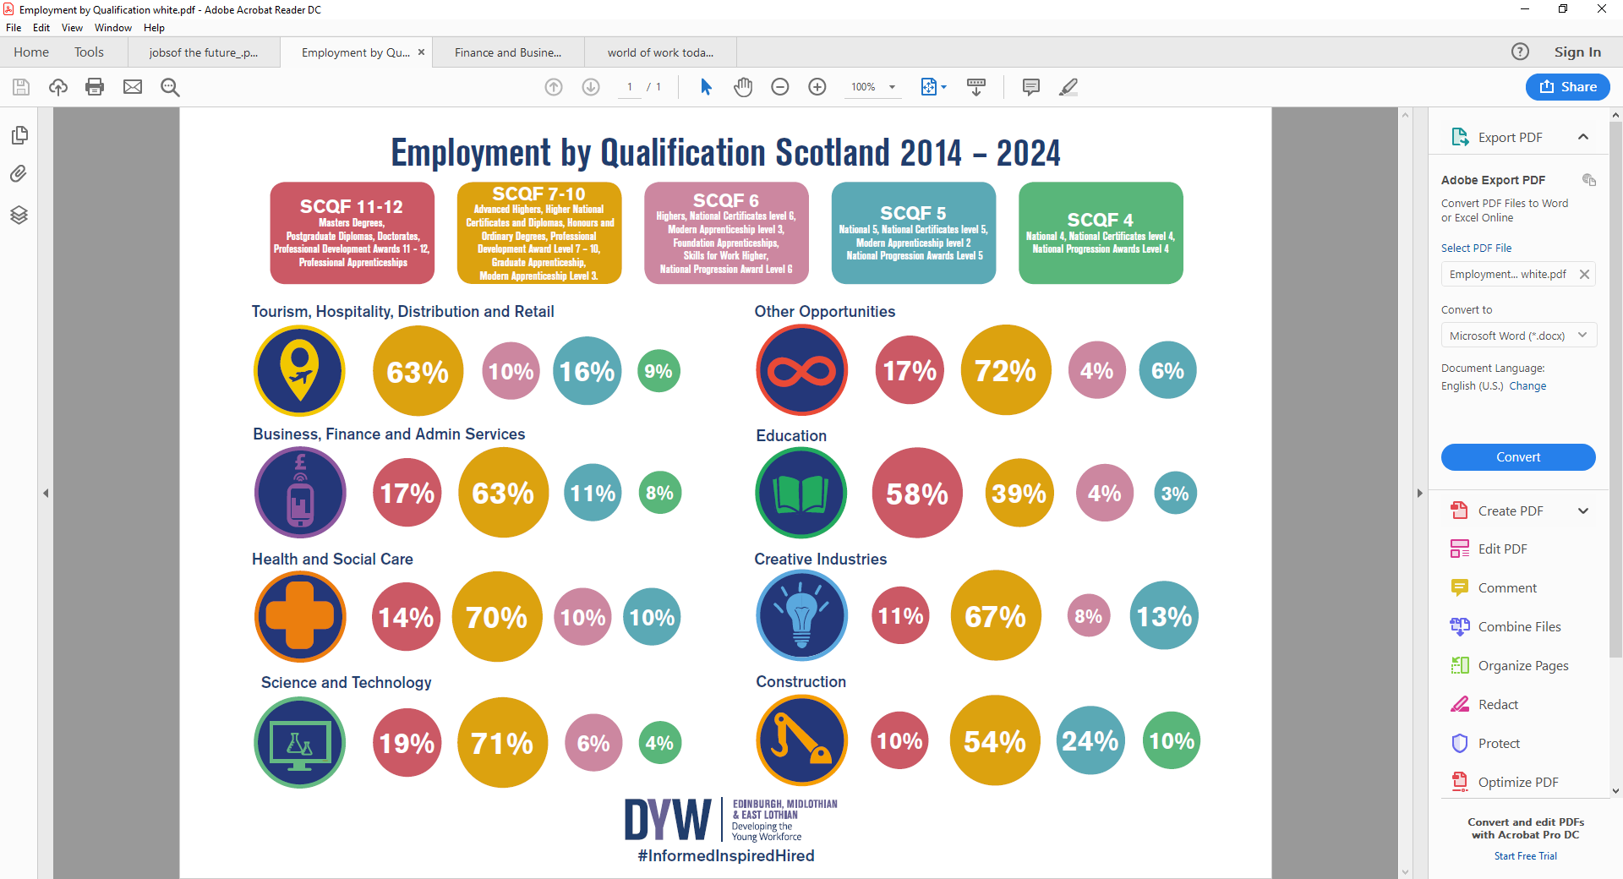

Slide 12
Additional Information
Labour Market Information – Edinburgh, Midlothian & East Lothian - DYW – Scotland
Pathways
https://www.apprenticeships.scot/
Progression Maps | Edinburgh College
Annual Participation Measure | Skills Development Scotland

