Slide 1
Subject choice N5 maths or N5 applications of maths?
Which course suits you best?

Slide 2
The maths journey
BGE 4th level secure. N4 units complete
N5 maths
Higher Maths
Advanced Higher
BGE 4th level consolidating. N4 units complete
N5 Applications of maths
Higher Applications of Maths
BGE 2/3rd level
N3/4 Applications of maths
EXIT POINT
Notes:
Creating another pathway for the pupils to achieve a national 5
The course is challenging and put pupils numerical skills to the test with both formal non-calculator and calculator exam at the end of the year.
The sole purpose of N5 maths is to prepare student to access Higher maths not function in the real world. N5 apps allows students to enter the world of work confidently.
David walkins has compiled a list of courses that accept N5 apps at university level, Nursing, teaching (excluding STEM subjects) this was shared on the Scottish maths teachers FB page which you should join if you are not already a member of.

Slide 3
N5 Applications of Maths
N5 Applications of Maths is a highly respected qualification which will open up many career opportunities for you.
The course explores the applications of mathematical techniques and skills in everyday situations, including financial matters, statistics, and measurement.
This course is accepted for many university courses. I will add a slide at the end with details of these.

Slide 4
N5 Applications of Maths
The following provides a broad overview of the subject skills, knowledge and understanding developed in the course:
♦ analyse real-life situations and problems involving mathematics
♦ identify valid mathematical operational skills to tackle real-life situations or problems
♦ select and apply numeracy skills
♦ select and apply skills in finance, statistics, measurement, geometry, graphical data and probability
♦ use mathematical reasoning skills to draw conclusions or justify decisions
♦ communicate mathematical information in an appropriate way

Slide 5
N5 Maths
N5 Maths is a highly respected qualification which will open up many career opportunities for you.
This is your more traditional maths course where you will study abstract maths. It is designed for those who want to go on and study maths at a advanced levels.
This course is compulsory for some university courses such as medicine and STEM subjects.

Slide 6
N5 Maths
The course explores:
understand and use mathematical concepts and relationships
select and apply numerical skills
select and apply skills in algebra, geometry, trigonometry and statistics
use mathematical models
use mathematical reasoning skills to interpret information, to select a strategy to solve a problem, and to communicate solutions

Slide 7
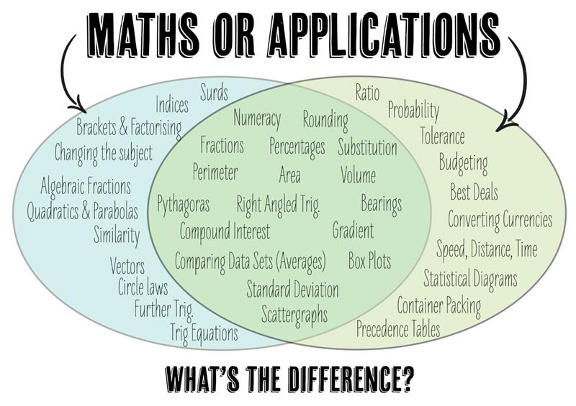
Topics in N5 maths an N5 applications

Slide 8
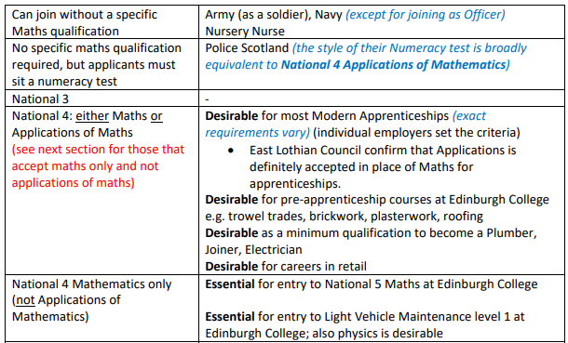
Sometimes these are minimum entry requirements and the particular employer, college or University you are applying to may ask for more. Always check their requirements carefully! Essential = you must have this qualification as minimum. Desirable = you may be able to get in without this qualification but it will help you to have it.

Slide 9
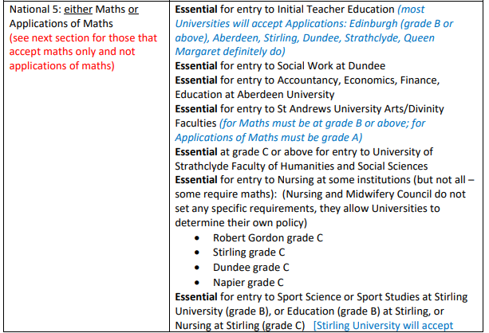
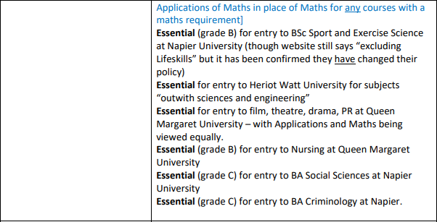
Sometimes these are minimum entry requirements and the particular employer, college or University you are applying to may ask for more. Always check their requirements carefully! Essential = you must have this qualification as minimum. Desirable = you may be able to get in without this qualification but it will help you to have it.

Slide 10
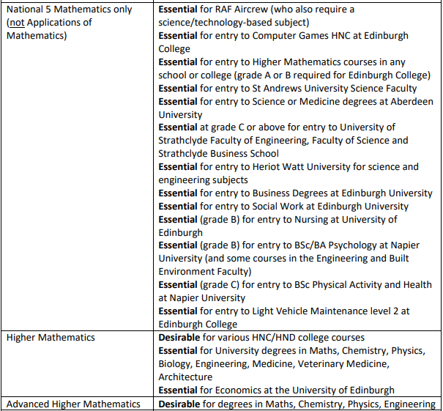
Sometimes these are minimum entry requirements and the particular employer, college or University you are applying to may ask for more. Always check their requirements carefully! Essential = you must have this qualification as minimum. Desirable = you may be able to get in without this qualification but it will help you to have it.

Slide 11
University closer to home UWS
Accept National 5 Application of Maths or N5 maths for following programmes:
PGDE Primary/Secondary
Nursing (both Adult and Mental Health)
Social Work
Midwifery
BA Education

